Slide 1
Apostrophes

Slide 2
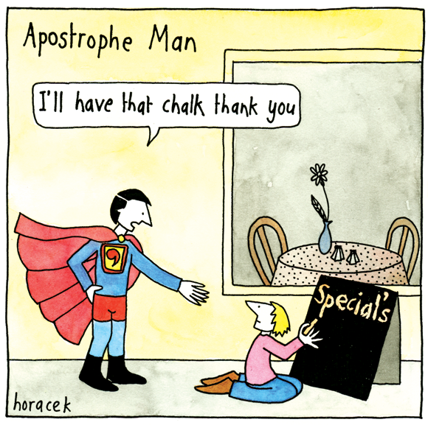
What’s wrong with this picture?

Slide 3
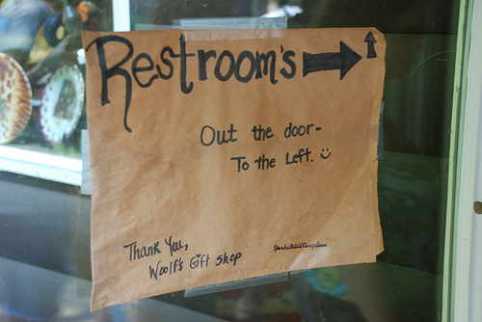
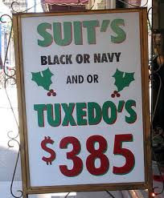
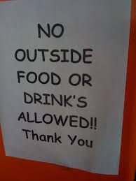
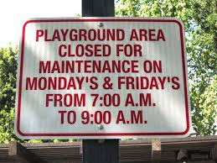
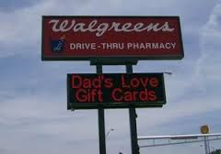
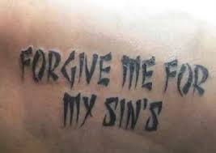
DON’T USE APOSTROHES TO MAKE SOMETHING PLURAL!!!
APOSTROPHAIL

Slide 4
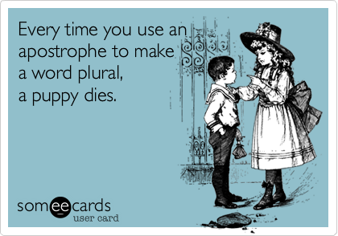
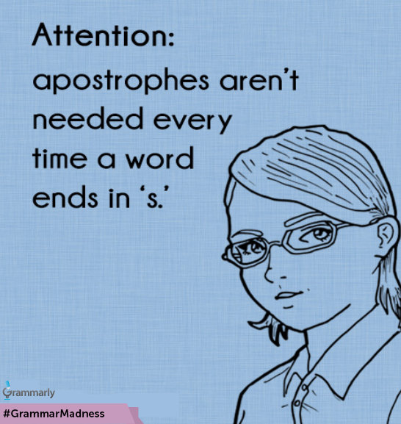

Slide 5
Uses for Apostrophes
For contractions
“Contract” means to ________ words.
The apostrophe shows missing letters.
E.g: “Hadn’t” is missing ___.
E.g.: “They’d” is missing _____.
E.g.: “Doesn’t” is missing ____.
E.g.: Mac’n’cheese is missing ___ and ___.

Slide 6
To Form Singular Possessives
Possession= ownership
If talking about ONE owner, the apostrophe goes INSIDE the s.
E.g.: the kite’s tail, the cat’s pajamas
To Form Plural Possessives
If talking about +2 owners, the apostrophe goes OUTSIDE the s.
E.g. dogs’ bones
Exception: men’s, children’s, women’s (irregular plurals)
Mnemonic: ONE dog can come INSIDE the house, but TWO or more dogs need to stay OUTSIDE.

Slide 7
To show shared ownership:
If two nouns SHARE something, put the apostrophe on the final noun.
William and Kate’s homework
If two nouns DON’T share, put the apostrophe on EACH noun.
William’s and Kate’s homework

Slide 8
3b. What if a singular noun has an “S” already?
s’ and ‘s are both correct
One syllable: try to use ‘s
boss’s orders
class’s homework
2+ syllables: try to use just an apostrophe.
Elvis’ guitar (Avoid Elvis’s)
Jesus’ teachings

Slide 9
5. To form CERTAIN plurals
Letters
I had two B’s.
Hawaii has two i’s.
When talking about words as words
He used three like’s in a sentence.
Uh’s and um’s distract me.
Puppies don’t die in these cases.

Slide 10
Please remove pages 29-32 from WriteSource.
Pre-AP: HW (Due tomorrow)
Standard: In class (Due at the end of the block)

