Slide 1
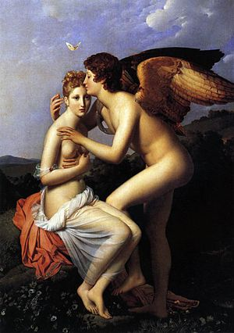
Cupid & Psyche

Slide 2
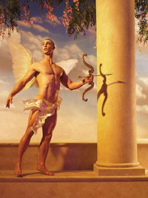
<The god of love, son of Venus and Mercury <Artistically, a beautiful, naked, boy with a bow. <Played many tricks on mortals and immortals
CUPID

Slide 3
Psyche
<AKA- The goddess of the soul
<Girl loved by Eros (Cupid)
<Mother of Voluptas
<Extremely beautiful

Slide 4
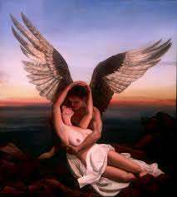
MYTH
<Psyche was a beautiful girl , so admired by young men that they neglected the worship of Aphrodite.
<Aphrodite was angry so sent her son Eros(Cupid) to cause Psyche to fall in love with a ugly monster, but Cupid fell in love with her.
<He sent her to a secret palace and made love to her each night under a cover of darkness, telling her she must not look upon him in light.
<Psyche was very curious to see her lover in the light so she went into the chamber where he was asleep and Cupid fled. She went after him, but Aphrodite thwarted her with mishaps.
<There were many tasks before getting married.
<In the end the two lovers reunited and married.

Slide 5
Archetypes
Star-Crossed Lovers
Cupid and Psyche
Light VS Darkness
Cupid and Psyche
White Goddess
Psyche

Slide 6
Citations
Mercatante, Anthony S., and James R. Dow. World Mythology and Legend: The Facts on File Encyclopedia Of.. 2nd ed. New York., NY: Facts on File, 2004. Print
"Cupid and Psyche." Cupid and Psyche. Web. 8 Apr. 2015. <http://www.pitt.edu/~dash/cupid.html>.
Mercatante, Anthony S., and James R. Dow. The Facts on File Encyclopedia of World Mythology and Legend (2-Volume Set). 3rd ed. New York: Infobase Pub., 2009. Print.

Slide 7
Themes
<Don’t try to be like the gods because they will punish you.
<Listen to your elders .

