Slide 1
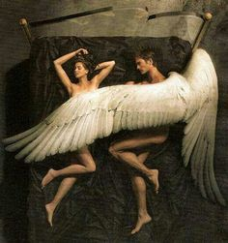
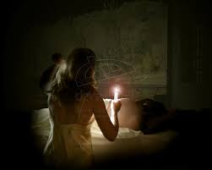
Cupid and Psyche

Slide 2
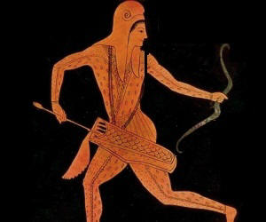
CUPID
Son of Venus (goddess of love and beauty)
Sent by his mother to make Psyche fall in love with a monster
Cupid fell in love with Psyche when he saw her beauty

Slide 3
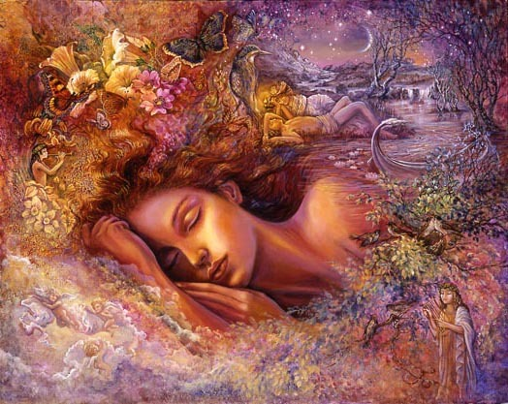
Psyche
Sister of Venus
Wife of Cupid
Goddess of the soul
Depicted in ancient mosaics as a butterfly winged Goddess

Slide 4
Myth
Venus sends Cupid, out of jealousy , to shoot an ugly beast with an arrow of affection towards Psyche.
Parents visited an oracle
Pysche was banished to the top of a mountain
“The man in the shadows” would appear at night to her as her husband
Sisters visited
Their jealousy of Psyche grew more and more
Find out who her secret lover was while he was sleeping
That night she used a candle and found out her lover was cupid
& he fled

Slide 5
Archetypes
Divine Interdiction
Cupid not revealing himself
The Shadow
Cupid coming in the night
The Castle
Psyche after banishement

Slide 6
Greek Culture
Destiny always prevails
Jealousy can lead to unintended permanent actions
Love conquers all

Slide 7
Works Cited
Grant, Michael. "The Invisible Lover." Myths of the Greeks and Romans. I ed. Vol. 16. Cleveland: World Pub., 1962. 408. Print.
"Home | Company.wizards.com." Web. 8 Apr. 2015. http://archive.wizards.com/
"Myths and Legends - The Tale of Cupid and Psyche." Web. 8 Apr. 2015. http://ancienthistory.about.com/cs/grecoromanmyth1/a/mythslegends_4.htm
"THEOI GREEK MYTHOLOGY, Exploring Mythology & the Greek Gods ..." Web. 8 Apr. 2015. http://www.theoi.com/

