Slide 1
Daedalus and icarus
Anna trejo, Denisse yeverino, Belen Charnichart, Isabel sandberg

Slide 2
Daedalus and Icarus symbol

Slide 3
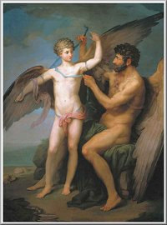
Daedalus and Icarus Information
Daedalus was a great inventor and architect
His sister is Perdix
He was child of either Metion or Eupalamus
Descendants from Erechtheus, King of Athens
Icarus son of Daedalus
Died escaping Crete

Slide 4
Daedalus and Icarus Background
Daedalus created the Labyrinth and placed the Minotaur in it
Daedalus built the Labyrinth to encase the Minotaur
Daedalus was banished to Crete to work for King Minos
Icarus and his father were escaping a Cretan prison on wings made of wax and feathers
Icarus ignored his father’s warning of flying to close to the sun
The wax melted and fell into the sea south of Samos
The sea was named Icarian after his death
The body washed ashore on an island named Icaria
Icarus was buried by Hercules

Slide 5
archetypes
Father-Son conflict- Daedalus and Icarus
The Outcast- Daedalus
The Fall- Icarus

Slide 6
Themes
Do not do anything that will exceed a God because you will be punished.
Obey your elders.

Slide 7
Works citied
Lowe, Alice, and Arvis Stewart. “Daedalus.” Greek Gods and Heroes. El Paso: Simon and Schuster, 2015. 139-145. Print
“Daedalus.” Myths and Legends of the World. Advameg, Inc. Web. 7 Apr. 2015
Sokolov, Ivanovich. Daedalus and Icarus. Digital image. Myth Man’s Greek Mythology Today. Web
Notes:
Two cities I used shmoop

