Slide 1
Demeter, Persephone, Hades
By: Brady I. Patrick
Tiffany C. Padilla
Kayla L. Wolf

Slide 2
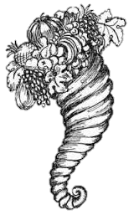
Demeter
Goddess of Harvest
Sister/Lover of Zeus
Mother of Persephone
Gaia (Mother Earth) was jealous of her

Slide 3
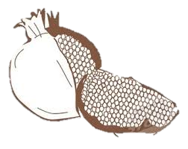
Persephone
Daughter of Zeus and Demeter
Niece/Wife of Hades
Extraordinarily Beautiful
Strong Willed (Stubborn)

Slide 4
Hades
God of the Underworld
Brother to Zeus
Persephone’s Uncle/Husband

Slide 5
Myth
Hades tells Zeus he pines over Persephone
Zeus spills
Gaia creates trap with a flower with pretty petals
Persephone sniffs and then falls into THE UNDERWORLD
Demeter looks for daughter and threatens world starvation
Persephone Refuses to eat
Hades persuades her to eat a pomegranate
However, a deal is struck; Persephone must spend one third of the year in the Underworld with Hades. This is Fall and Winter.

Slide 6
Archetypes
The Outcast
Hades
The Fall
Persephone falls from loved daughter to abducted niece
Heaven vs. Hell
She literally goes back and forth between Heaven (Mount Olympus) and Hell (Underworld)
Black Temptress
Gaia tempts Persephone into picking the flower

