Slide 1
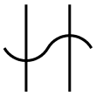
Hercules
By Emeka, Diego, and Hugo

Slide 2
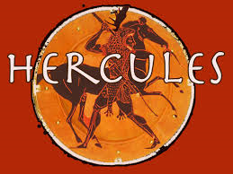
Description
Hercules was a demigod that was the son of Zeus and Alcmene
He was born with superhuman strength and stamina
He was extremely courageous and self-confident

Slide 3
Myths
Hera wanted to create many problems for Hercules
She caused him to go berserk, which resulted in him killing his wife and children
After recovering from his insanity and feeling remorseful for his action, He prayed to Apollo for help
Apollo tells him that he would need to serve Eurystheus (king of Tiryns and Mycenae) for 12 years for his chastisement
As part of his punishment, he had to perform 12 seemingly impossible tasks

Slide 4
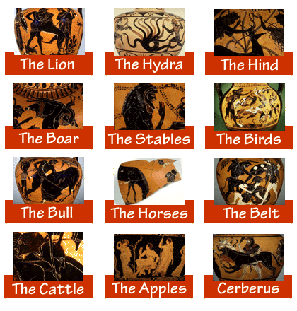
Myths
The tasks were the following:
Kill and skin the Nemean lion
Kill the Lernean hydra
Retrieving the hind of Ceryneia Diana’s pet deer
Retrieve the Erymanthian boar
Cleaning the Augean stables
Killing Ares’ Stymphalian birds
Disposing the Cretan Bull
Retrieving the Man-eating horses of Diomedes
Kill Hippolyte, the Amazon queen, and retrieve her belt
Travel to the end of the world to get the cattle of Geryon
Retrieving the golden apples of Hesperides
Go to the underworld and kidnap Cerberus

Slide 5
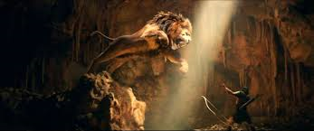
Myths
Hercules became Greece’s greatest hero
After the12 labors Hercules had any other adventures which eventually resulted in his death
The gods resurrected him for his deeds and made him immortal
His struggles caused him to be the personification of what the Greeks called Pathos (Greek word for the experience of virtuous struggles and suffering that lead to fame)

Slide 6
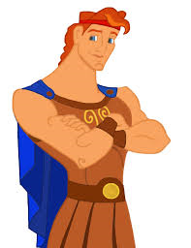
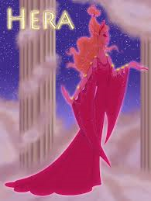
Archetypes
Hero
Hercules is the protagonist of the myth and is characterized with great strength and bravery
Devil Figure
Hera is the devil figure as she caused Hercules much distress and got him in his situation
Creature of Nightmare
The Nemean lion, the Lernean hydra, the Erymanthian boar, the Stymphalian birds, the Cretan bull, the man-eating horses of Diomedes, and the Cerberus are all hostile beast that attempted to dispatch Hercules

Slide 7
Greek Culture
Power
Human like behavior for the gods
Greeks believe immortality could be achieved by great feats
How much Greeks admired heroism

Slide 8
Bibliography
Moskowitz, Denis. "New Constellation Symbols." suberic. Last modified Sep 29 2010. . 7 April, 2015. <http://www.suberic.net/~dmm/astro/constellations.html>.
Tufts University. "The Labors of Hercules." perseus.tufts. . subset of materials from the Perseus Project . 7 April, 2015. <http://www.perseus.tufts.edu/Herakles/labors.html>.
Switzer, Ellen and Costas. Greek Myths: Gods, Heroes and Monsters. New York: Atheneum, 1988.

