Slide 1
Literary Elements

Slide 2
Literary Elements: CCSSPPTT
Mnemonic device to remember all the elements:
C
C
S
S
P
P
T
T

Slide 3
Literary Elements
Why review these?
Common academic vocabulary for English
Annotations
Short answers
Essays
Better understanding of literature

Slide 4
Characterization
Characterization (aka, character development) is the act of building a believable, sympathetic character.
Direct characterization: The author directly TELLS a character’s traits
Example: “Michael was a very hardworking person.”
Indirect characterization: The author indirectly SHOWS a character’s traits through their appearance, actions, thoughts, dialogue, and the opinions of other characters.
Example: “Michael pulled an all-nighter to finish his English homework.”

Slide 5
Characterization (Continued)
Classifications of characters
Levels of detail
Round: Fully developed, with many traits—bad and good—shown in the story. Readers feel that they know the character so well that he or she has become a real person.
Ex: Rick Grimes (TWD) is both honorable yet savage.
Flat: Not fully developed; readers know only one side of the character.
Ex: Zombies in TWD are only shown as vicious.
Flat ←----------------------------------------------------------------------------------→Round

Slide 6
characterization (Continued)
Levels of change
Dynamic: a character who does experience a basic character change during the course of the story. This change is internal and may be sudden, but the events of the plot should make it seem inevitable.
Ex.: Beast (BaTB) learns not to judge others.
Static: a character who does not experience a major internal change during the course of the story.
Ex.: Gaston is arrogant throughout.
Static ←----------------------------------------------------------------------------------→Dynamic
Levels of Reader involvement
Sympathetic/unsympathetic:
If a character is likeable, he or she may be referred to as a sympathetic character. A dislikeable character is unsympathetic. Ex. Belle in BatB.

Slide 7
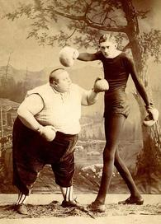
characterization (Continued)
Protagonist: The central/main character in the plot’s conflict. The “hero” or the person undergoing change
Ex. Harry Potter
Antagonist: The force in conflict with the protagonist. It may be society, nature, or fate, as well as another character. It can even be the protagonist him/herself!
Ex. Voldemort
Foil: A character whose traits are directly opposite of the main character. Thus, they highlight the main character’s personality even more.
E.g. Draco Malfoy

Slide 8
Conflict
The struggle between the protagonist and an opposing force. Drives the plot/events and reveals theme.
Two major types:
Internal:
Person vs. Self: Occurs when the protagonist struggles with his/her conscience. The protagonist is pulled by two courses of action or by differing emotions.
External:
Person vs. Person
Person vs. Society
Person vs. Nature
Person vs. Technology
Person vs. Supernatural
ETC.

Slide 9
Setting
The time period and location/climate in which the story takes place.
Integral: The setting is important to the story. It affects theme and tone. It is mentioned throughout.
E.g. Gotham City in The Dark Knight Rises
Backdrop: The setting isn’t important to the story. It is only mentioned briefly. it is like the flat painted scenery of a theatre
E.g. Connecticut in The Babysitter’s Club

Slide 10
Symbolism
A symbol is something concrete—such as a person, place, or object—that signifies something more than just itself, something abstract, such as a concept or an idea.
E.g. a dove (concrete) represents ____________.

Slide 11
PLOT
What happens in the story; the chain of events
Exposition: How the story starts;
Background information (setting, characters)
Meet protagonist before his/her big change
Rising Action: A problem occurs/antagonist enters. Further tension is built through a series of complications, incidents which either help or hinder (hurt) the protagonist in finding the solution to the problem.
Climax: The highest peak or turning point of the action; at this point we know the outcome. The two forces in conflict come together and the protagonist either wins or loses.

Slide 12
Plot (continued)
Falling Action: The events that occur after the climax. They give any necessary information or explanations and “tie up loose ends.:
An epiphany or moment of clarity occurs.
Resolution: how the story ends; the sense at the end of the story that the story is complete and the protagonist is now different.
Closed resolution: The various parts of plot are tied together satisfactorily, and the reader feels a sense of completion. The author’s message about an issue is clear.
Open resolution: Readers must draw their own conclusions; the author lets us decide what to think about an issue.

Slide 13
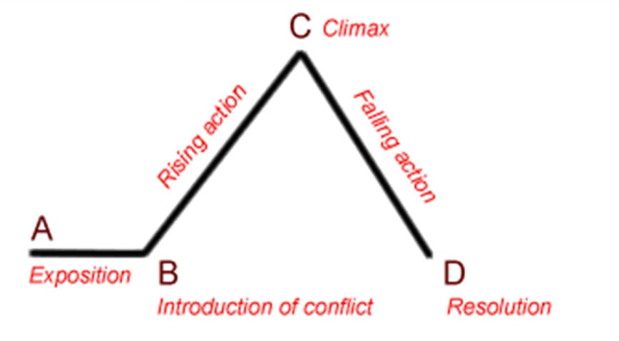
plot (Continued)
Freytag’s pyramid:

Slide 14
Point of view
The vantage point from which the story is told. Who is the narrator and how is he involved in the story?
1st person:
The narrator is a character in the story, usually the protagonist. She tells the story from her own experience.
Key pronouns: I, me, my
Unreliable narrator, ex. a criminal
Innocent eye narrator, ex. a young child

Slide 15
point of view (continued)
3rd person: The narrator is not a character in the story. Key pronouns: he, she, they, it, him, her, etc.
3rd person dramatic/objective:
The narrator does not reveal any thoughts or feelings of the characters. Readers are told only what happens and what is said. It is called “dramatic” because it is what you usually see and hear in a movie or play. It is called “objective” because it is based on facts.
Ex.: Narrator on “The Discovery Channel”
3rd person limited:
Narrator reveals the thoughts and feelings of only the main characters.
Ex.: Owls in Rango (focus on Rango)
3rd person omniscient:
Narrator follows the thoughts and feelings of most or all the characters. “Omniscient” means having unlimited knowledge.
Ex. Lord of the Rings trilogy

Slide 16
Theme
The underlying meaning of the story; expressed as a COMPLETE sentence, not just a topic.
ADD THIS: It must contain at least ONE abstract noun!!
Ex: “Love conquers all,” NOT “Love” by itself.
Explicit: The author directly TELLS readers the theme
Implicit: The author indirectly SHOWS readers the theme; must be inferred.

Slide 17
Tone
Tone is the overall attitude of the AUTHOR towards his/her subject. It is INFERRED through a writer’s specific word choices, language and images.
Ex: Bitter, serious, witty, playful, etc.
Mood: a close relative of tone, except it is the overall atmosphere/emotion evoked in the READER.
Ex: Scary, gloomy, sunny, etc.
You will get a longer list of these in the future.

