Slide 1
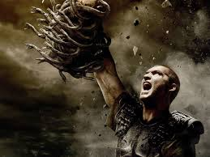
Perseus and medusa
By: Josh Shapiro, Pablo Macias, Alyssa Saucedo

Slide 2
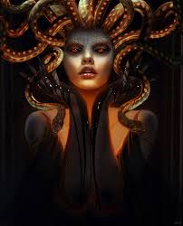
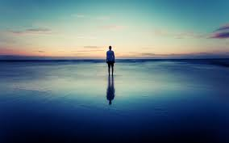
Characters: Medusa
One of the 3 sisters known as the Gorgons (only mortal one)
Was turned into horrific creature by Athena (for breaking her vows)
Eye contact would turn one into stone
Killed by Greek hero, Perseus

Slide 3
CharacterS: Perseus
Known as the Destroyer
Son of Zeus and Danae
Protected Danae from Polydectes
Sent on a quest by Polydectes to bring Medusa’s head back
Accomplished it with the help of Hermes and Athena

Slide 4
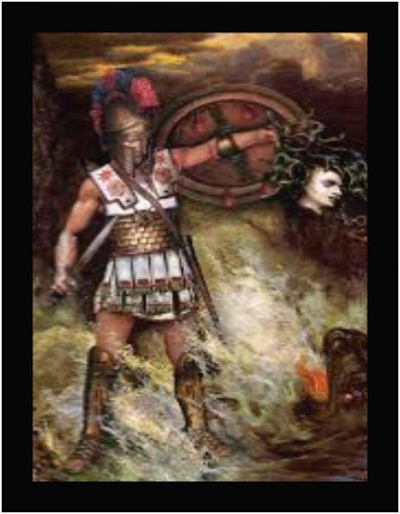
Myth
Perseus and his mother Danae lived on the island of Seriphos.
Island was ruled by Polydectes.
Polydectes was in love with Danae and devised a plan to marry her without the objection of her son Perseus.
He sent Perseus on a quest to kill and decapitate the Gorgon known as Medusa. (to get rid of him)
Perseus returns home with Medusa’s head.
He realizes the plan of Polydectes and turned him to stone using the head.

Slide 5
archetypes
Perseus- Hero
Medusa- Creature of Nightmare
Polydectes- The Shadow

Slide 6
Greek culture
Heroism is earned not given.
The mother-son relationship is sacred.
Mercy is sometimes overlooked.

Slide 7
Works cited
Parks, Rebecca. UXL Encyclopedia of World Mythology. Vol. 4. Detroit: Gale Cengage Learning, 2009. 684-685;826-827,. Print
Hunter, James. “Perseus”.Encyclopedia Mythica. 3 March 1997. Web. 7 Apr. 2015.
Dow, James. World Mythology and Legend. 2nd ed. Vol. 11. New York: Facts o nFile,2004. 692-693. Print.

