Slide 1
Prometheus and Zeus
(the creation of man)

Slide 2
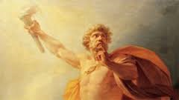
Prometheus
Son of a Titan
Had three brothers (Epimetheus)
Created beasts and man
Gave mankind fire
symbol
Fire

Slide 3
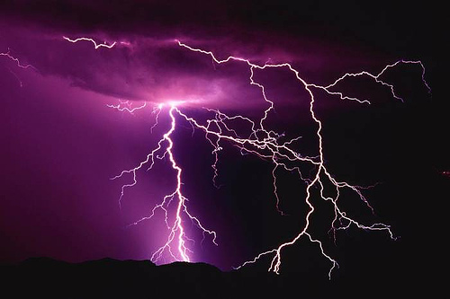
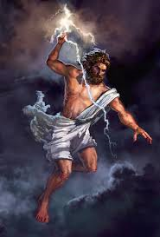
Zeus
Son of Cronus and Rhea
Brother of Hades, Hestia, Hera, and Poseidon
Father to Ares and Athena
The only god that is the father of other Olympian gods
Called the master of lighting, the mighty thunderer,
God of storms and rain
symbol
Lighting bolt

Slide 4
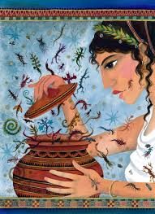
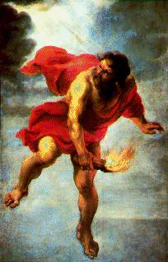
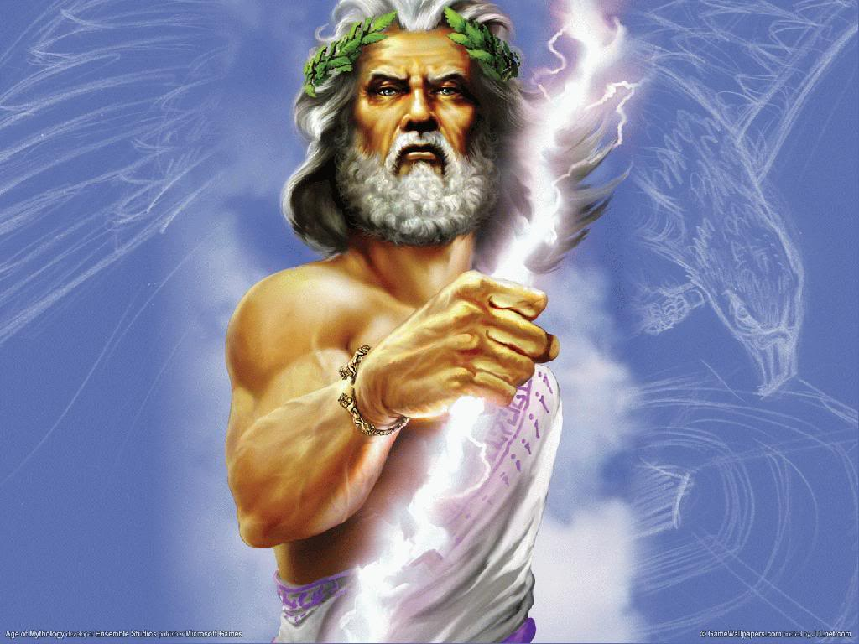
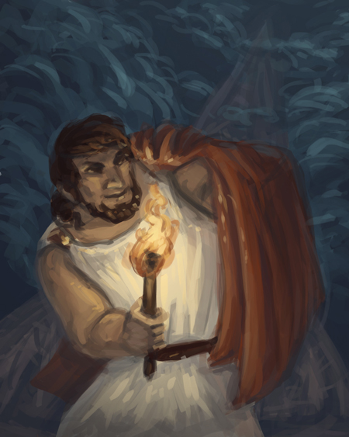
myth
Prometheus and Epimethus were given the responsibility of creating man
His brother would give out the qualities but when he got to man all the good qualities were gone
Prometheus made man stand up right like the gods and gave them fire.
Prometheus started to love man more then the gods
Zeus wanted man to give his a sacrifice of each animal they killed
Prometheus tricked Zeus into picking the wrong pile of meat
Zeus took fire away from man and then Prometheus gave it back to them
Zeus then created Pandora to punish man and she released sorrows, plagues, misfortune, and hope

Slide 5
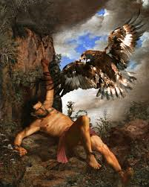
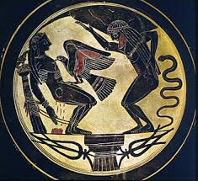
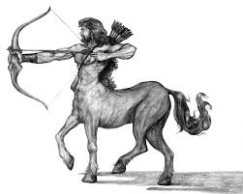
myth cont.
Zeus punished Prometheus by chaining him to Caucasus mountains where a eagle tormented him
Was eventually saved by Chiron the centaur and Heracles

Slide 6
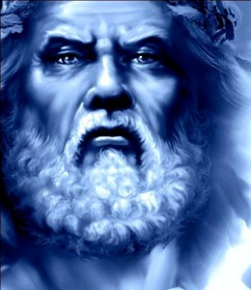
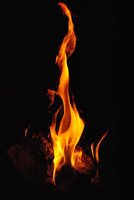
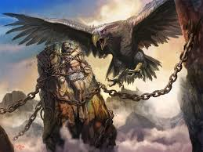
Archetypes
The outcast (Prometheus)
Fire and ice ( Prometheus replaced the fire)
The fall(Prometheus)

Slide 7
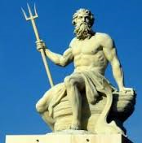
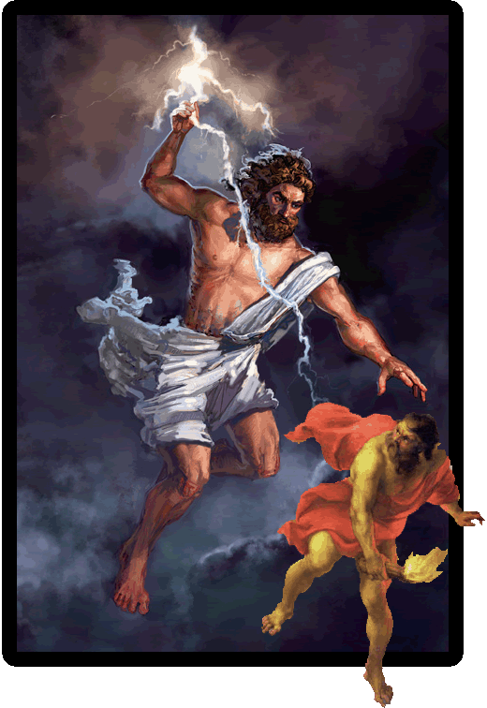
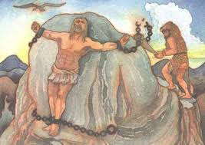
Culture
Defying the established order
Pride should be taken in moderation
Suffering can save people

Slide 8
Works cited
Mercatante, Anthony. World Mythology and Legends. Second ed. Vol. 2.1988. Print.
Hunt, John. "The Creation of Man by Prometheus." Desy. Web. 6 Apr.2015.<http://www.desy.de/gra/interpedia/greek_myth/creationMan.html>.

