Slide 1
The Judgement of Paris and The Gods and Goddesses of The Trojan War
Eve Albert, Hannah Littlefield, and Andrea Thatch

Slide 2
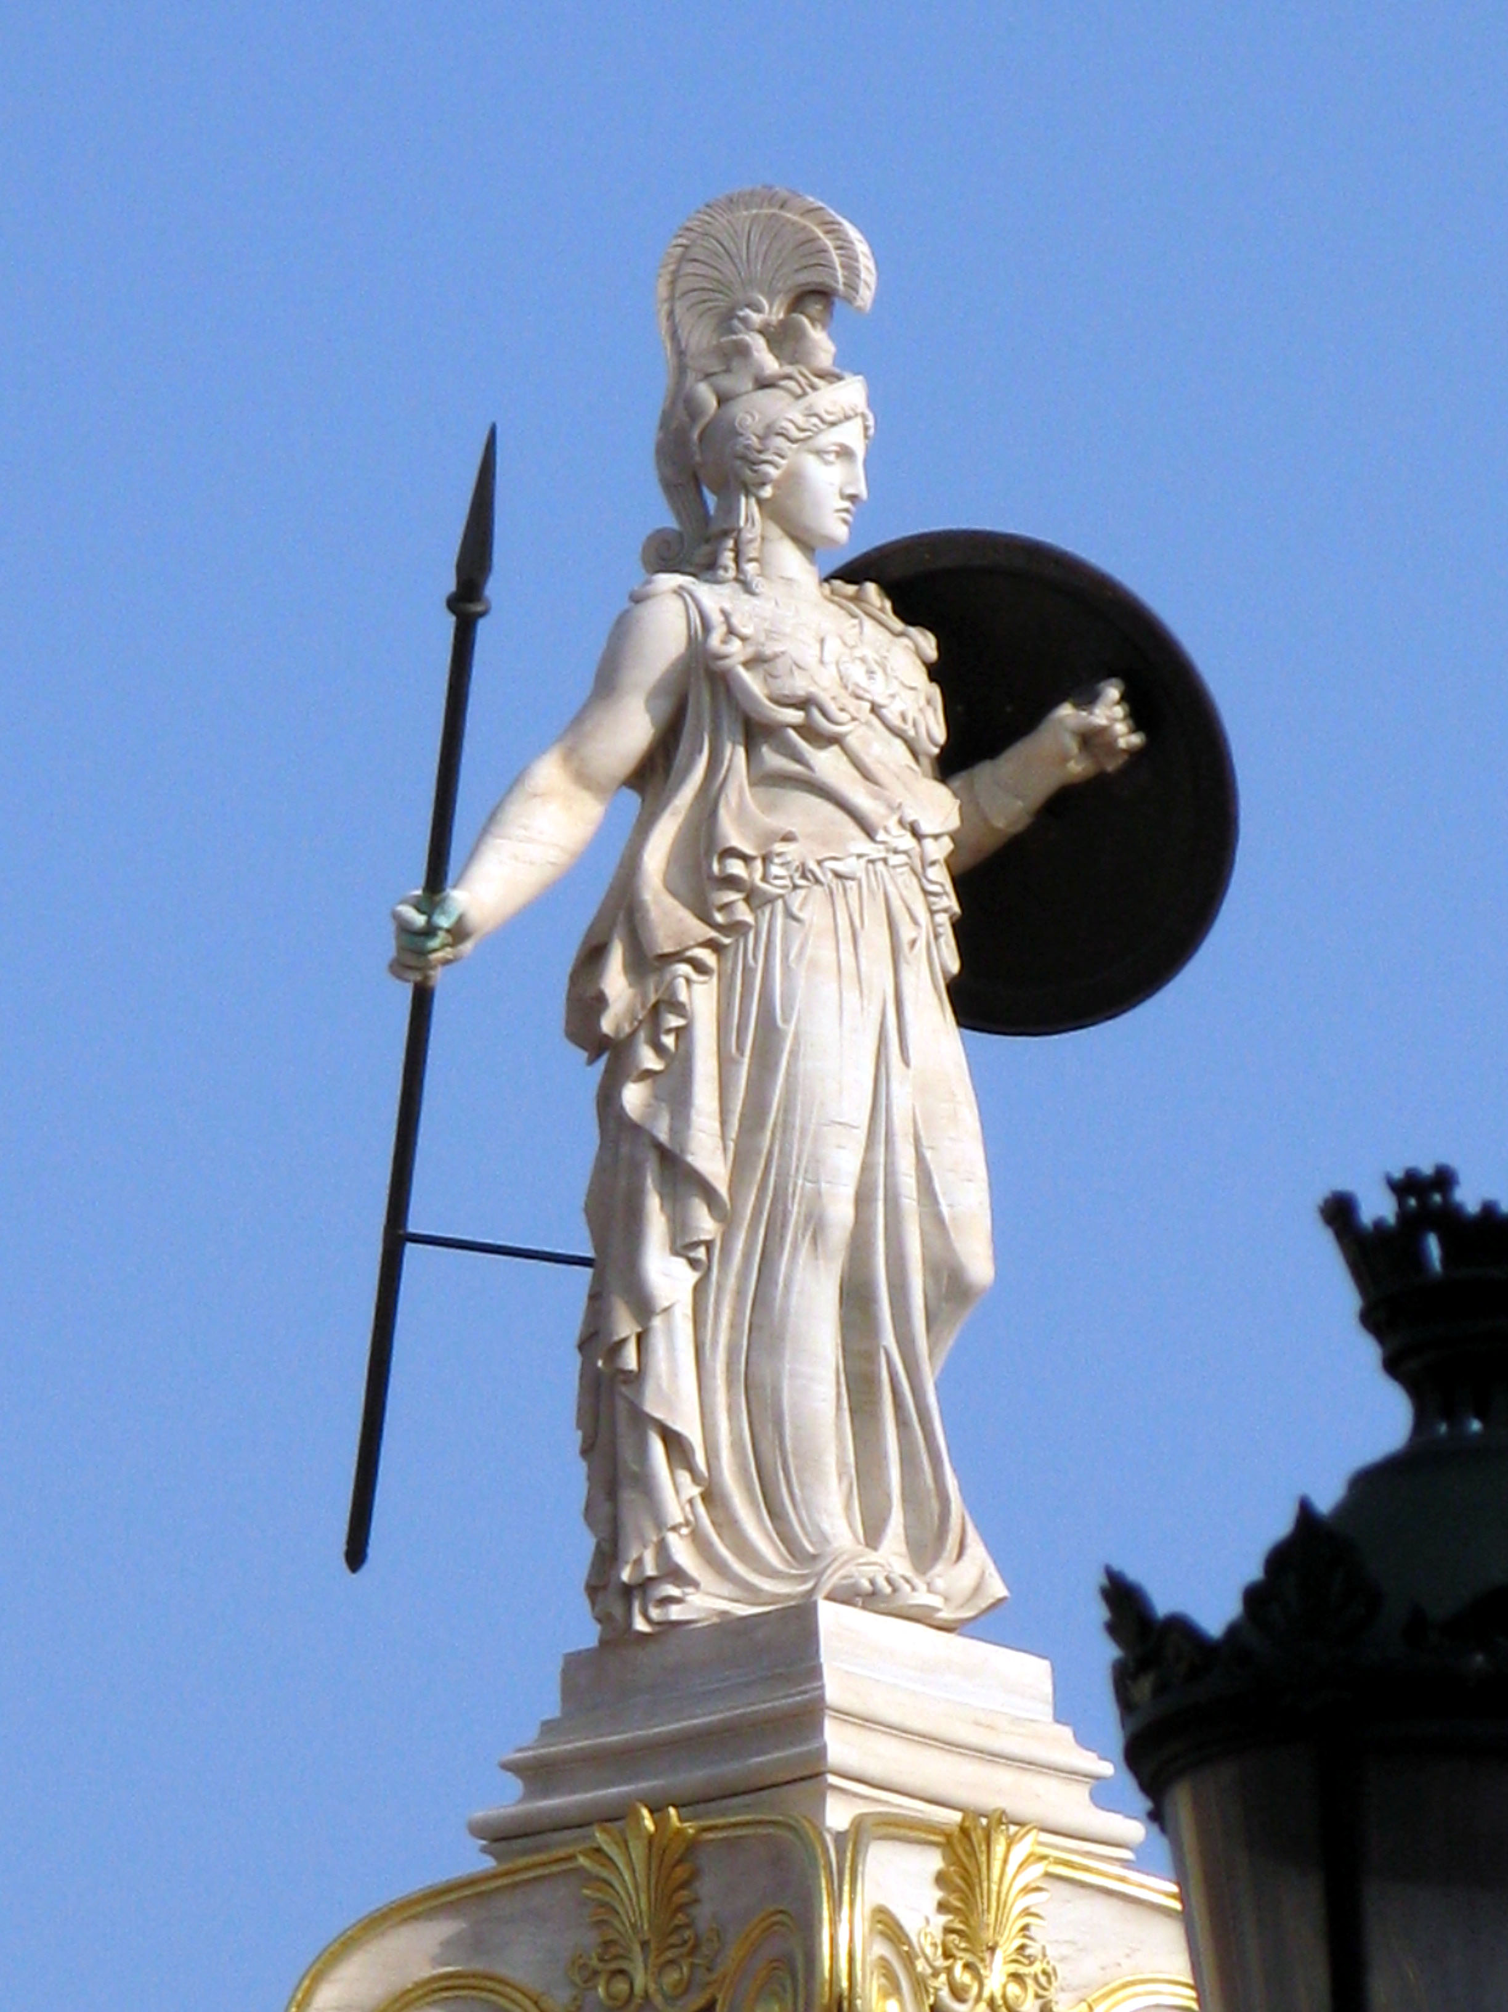
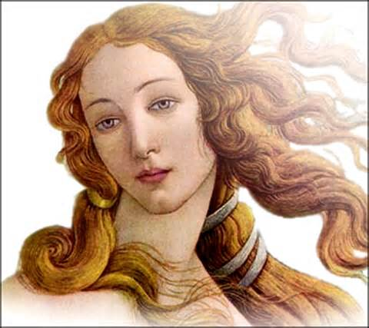
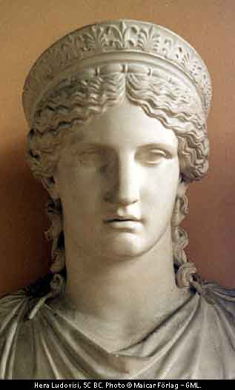
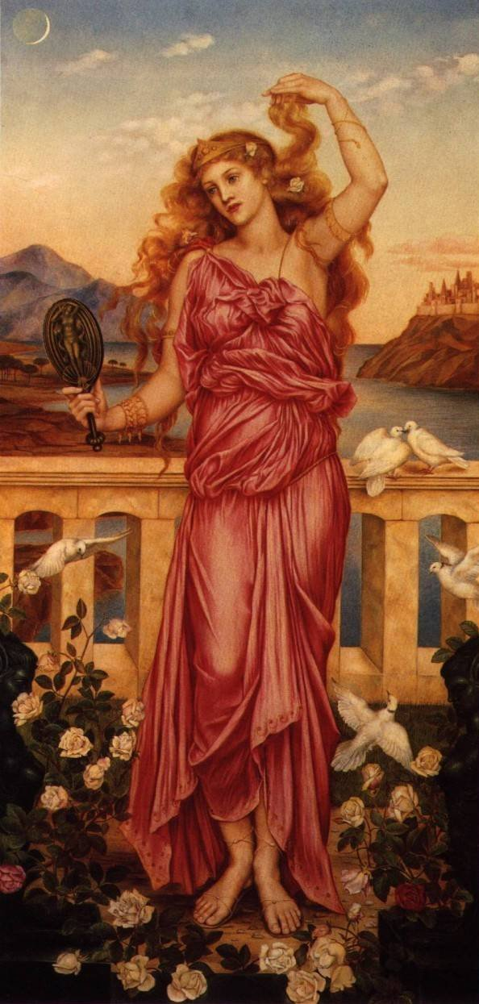
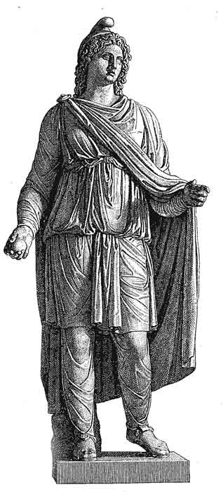
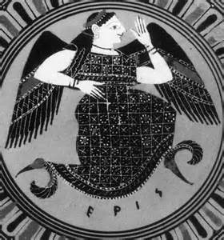
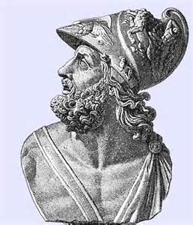
Athena
Aphrodite
Hera
Helen
King Menelaus of Sparta
Paris
Eris

Slide 3
Aphrodite- Goddess of love, beauty, and desire. Supported Trojan
Athena- Goddess of wisdom and war. Supported Greeks
Hera- Supreme goddess of marriage and family. Wife/sister of Zeus. Supported Greeks.
Paris- Trojan prince
Helen- the most beautiful woman. Wife of King Menelaus
Eris- Goddess of discord and chaos.
Ares- God of war. One of the twelve Olympians. Son of Zeus and Hera. Supported Trojans
Artemis- Olympian goddess of hunting and wilderness. Supported Trojans
Apollo- God of healing and light. Son of Zeus, twin brother of Artemis, god of music. Supported Trojans
Poseidon- God of seas. Brother of Zeus and Hades. Supported Greeks
Zeus- God of the sky. Ruler of the Olympian gods. Neutral.

Slide 4
Judgement of Paris
All gods and goddesses were invited to Peleus and Thetis’ wedding except Eris.
Eris threw a golden apple to the goddesses address “To the Fairest.”
Aphrodite, Athena, Hera all claimed the apple.
Zeus appointed Paris to decide who would receive the apple.
All of the goddesses attempted to bribe Paris in order to claim the apple, but Paris chose Aphrodite who had offered him Helen.
This abduction of Helen led directly to the Trojan War.

Slide 5
Archetypes
Scapegoat
Paris
The Temptress or Black Goddess
Aphrodite, Hera, and Athena
The Unfaithful Wife
Helen

Slide 6
Greek Culture
This reveals that the Greeks thought the Gods were greedy and selfish.
The Greeks worshiped them even more because they were very fearful of them and their power.
The Greeks thought the Gods were always competitive.

Slide 7
Works Cited
"Judgement of Paris." Theoi Greek Mythology. Ed. Aaron Atsma. 1 Jan. 2000. Web. 7 Apr. 2015. <http://www.theoi.com/Olympios/JudgementParis.html>.
Gill, N.S. "Gods and Goddesses in the Illiad." About Education. Web. 7 Apr. 2015. <http://ancienthistory.about.com/od/trojanwararticles/a/072610-Gods-And-Goddesses-In-The-Iliad.htm>.
"The Illiad." U.X.L. Encyclopedia of World Mythology. Ed. Rebecca Parks. Vol. 3. Farmington Hills: Gale, Cengage Learning, 2009. 568. Print.

