Slide 1
The Story of Prometheus and Zeus
The Creation of Man

Slide 2
Prometheus
Name means “forethought” meaning he can predict the future
Son of Titan Iapetus his mother was Clymene
Known as the god who gave fire to humans
Creator of mankind
Had eternal life
Symbol: Fire is one of many of the gifts that Prometheus gave humanity and symbolizes the human progress.

Slide 4
Zeus
Zeus is the god of the sky, ruler of the Olympian gods, and father of men
Zeus always made sure that each deity performed their individual duty, punished their misdeeds, and settled their disputes.
He is known to be grand, strong and imposing, with long curly hair.
Symbols: The symbols of Zeus are the scepter, the throne, the thunderbolt, oak tree, and his sacred animal is the eagle.

Slide 5
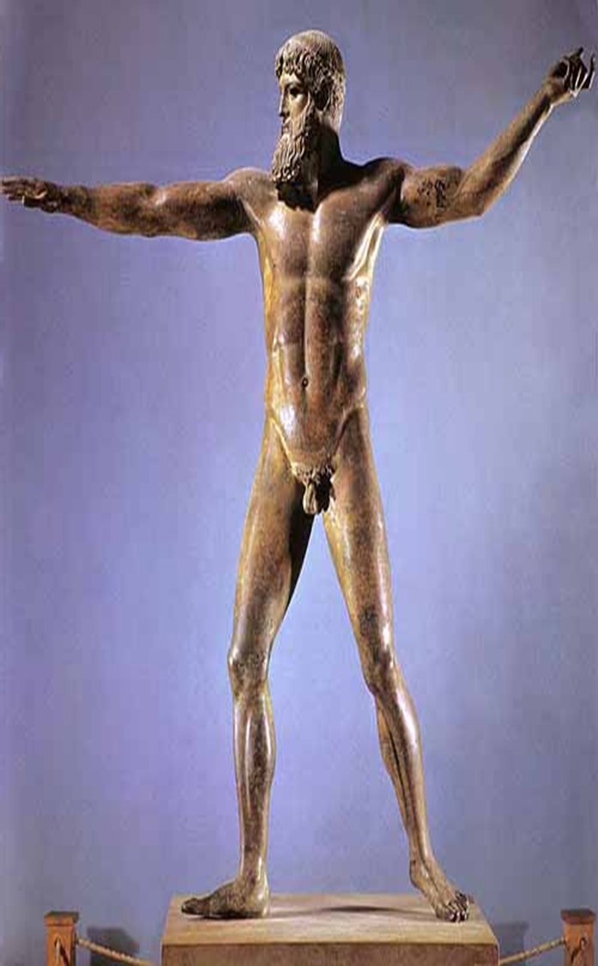
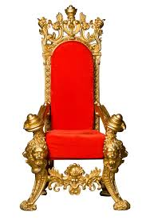
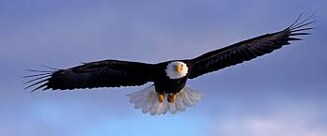
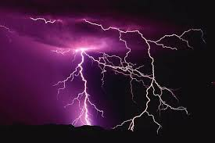

Slide 6
The Creation of Man
Man was created by Prometheus and Epimetheus, Titan brothers.
The brothers were supposed to be imprisoned because they did not fight along the Titans during Titanomachy, a war between the Titans and the Olympians.
In place of going to prison, they were given the task of creating man
Prometheus made man while Epimetheus gave all the creatures of the world qualities (swiftness, strength, fur, etc.)

Slide 7
Cont.
Prometheus shaped man out of clay, and the goddess Athena, breathed life into them
When Epimetheus got to man after giving the rest of the creatures qualities, he had run out of qualities
To make up for wasting the qualities, he made man stand up right like the gods and gave them fire

Slide 8
Cont.
Prometheus loved man more than the Olympians, since they banished his family
When Zeus demanded man to sacrifice a portion of food to the gods, Prometheus decided to trick Zeus
He created two piles one with bones wrapped in juicy meat, and one with the finest meat hidden in a hide.
Zeus chose the bones, but was angry when he found out he was tricked.

Slide 9
Punishment
Zeus takes fire away from man so Prometheus steals fire from his lighting rod
Prometheus was tied to a rock with an unbreakable chain made of diamonds
And every morning a crow came and ate Prometheus insides and during the night he regenerated and grew his insides back
Mankind was sent a beauty, Pandora, who was sent to earth by Zeus with a forbidden jar
She was tempted by the jar and opened it, releasing all the evils upon earth leaving only hope in the jar.

Slide 10
Greek Culture
This myth illustrates that the Greeks believed…
Every action comes with an equal consequence
Sacrifice is important in a functional society

Slide 11
Archetypes
Archetypes
The Hero
Prometheus betrays the gods and steals fire for the mortals
The Temptress
Zeus sends Pandora to Earth to give he mortals hardships
Fire and Ice
Mortals live without out fire in darkness

Slide 12
Work cited
Press, Petra. "Traditional Heroes." Great Heroes of Mythology. New York: Metro, 1997. 8. Print
"Creation of Man by Prometheus." Creation of Man by Prometheus. Web. 7 Apr. 2015. <http://www.greekmythology.com/Myths/The_Myths/Creation_of_Man_by_Prometheus/creation_of_man_by_prometheus.html>.
." The Columbia Encyclopedia, 6th ed.. 2014. Encyclopedia.com. 7 Apr. 2015 <http://www.encyclopedia.com>.

