Slide 1
Warm-Ups, NW3, Week 6
Focus on Brushstrokes (Adjectives Out of Order)

Slide 2
Monday, February 9th
Identify the following underlined phrases and explain.
Trees staring at me, the sun setting down, I was lost in the middle of nowhere. (7th)
Tusks twisting, anger flowing, the elephants fought. (7th)
Clashing amicably, the two young elephants’ faces collided, interwining, loving, feeling each other’s warmth. (1st)
The boys, wrestling each other to get the ball, laughing all the way, never really noticed the true friendship they had. (4th)
Romeo, a hopeless romantic, leaned against the wall for support, trying to quell the ache in his chest. (4th)
Roads diverging, paths leading to different lives, the man chooses the road that is less travelled. (1st)
The boys attempted to hit the ball, jumping high into the air as if their life depended on being the first. (1st)

Slide 3
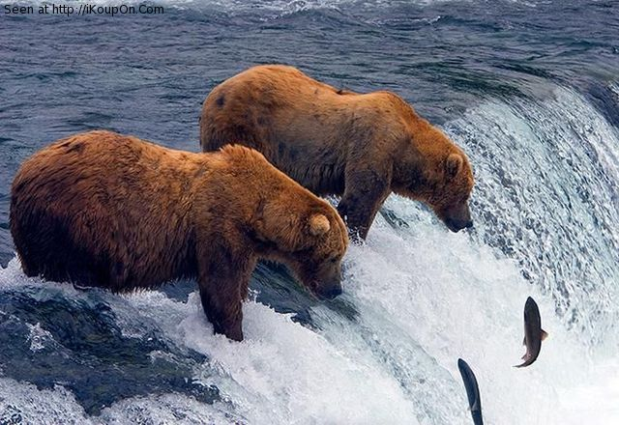
Tuesday, February 10th
Brushstroke #4
Write a simple sentence about the image
Come up with adjectives to describe your subject
Pick three of the adjectives; put one before the noun and two after it (enclose them in commas)

Slide 4
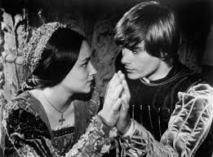
Wednesday, February 11th
Brushstroke #4
Write a simple sentence about the image
Come up with adjectives to describe your subject
Pick three of the adjectives; put one before the noun and two after it (enclose them in commas)

Slide 5
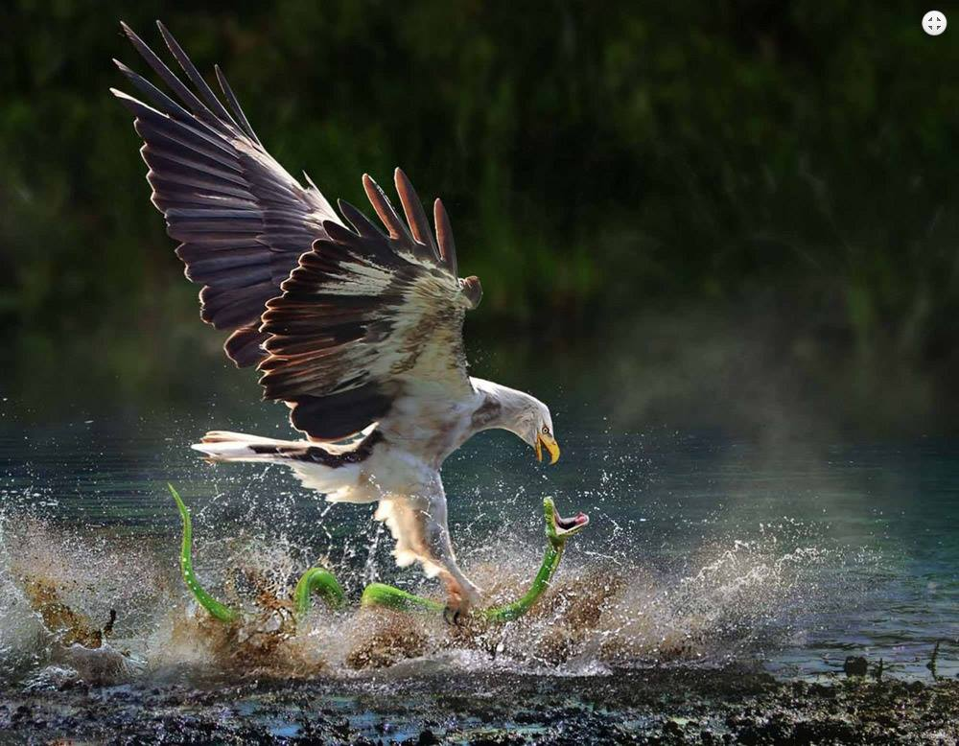
Thursday, February 12th
Brushstroke #4
Write a simple sentence about the image
Come up with adjectives to describe your subject
Pick three of the adjectives; put one before the noun and two after it (enclose them in commas)

