Slide 1
Warm-Ups, NW3, Week 8
Focus on Brushstrokes (Active Voice)

Slide 2
Monday, February 23rd
Copy both sentences:
The gravel road was on the left side of the barn.
The gravel road curled around the left side of the barn.
Out of the two sentences above, which is preferable and explain why in a complete sentence.

Slide 3
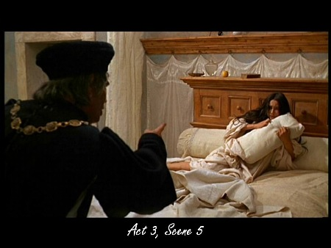
Tuesday, February 24th
Write a complete sentence about the image to the right. Use ACTIVE voice (Use a strong verb other than a form of “be”).

Slide 4
Wednesday, February 25th
Rewrite the following passive sentences into active voice.
A roar was given by the crowd.
Many of the ornaments were made by my grandmother.
A decaying tooth has been extracted.
The actor was acclaimed for his performance.
The blue ribbon was won by a friend of mine.
The air conditioner will be delivered later in the day.

Slide 5
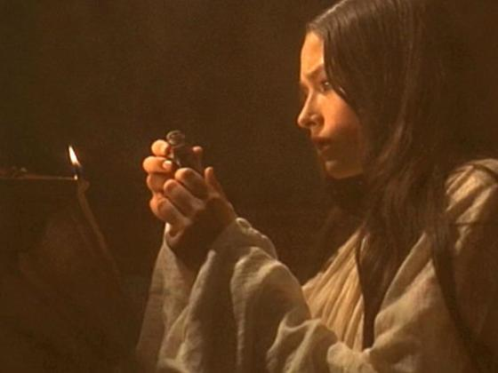
Thursday, February 26th
Write a complete sentence about the image to the right. Use ACTIVE voice (Use a strong action verb other than a form of “be”; make sure your subject is ACTING/doing something).
Include a 2nd brushstroke of your choice.
Quiz tomorrow

