Slide 1
Warm-Ups, NW3, Week 6
Focus on Brushstrokes (Adjectives Out of Order)

Slide 2
Monday, February 16th
No School (President’s Day)

Slide 3
Tuesday, February 17th (Pre-AP)
Add commas to the sentences below (Write the whole sentence). Identify the brushstroke.
Lights dimming moon rising the stillness of the night crept up on the houses. (2 commas; 1 brushstroke)
The bird nonchalant and free defiantly made fun of the trapped cat. (2 commas; 1 brushstroke)
The sun light of our life still shined bright from light years away. (2 commas ; 1 brushstroke)
Walking leaping rolling the astronaut a skilled professional has created the illusion that he is walking atop the beautiful round globe in which we live. (6 commas; 2 separate brushstrokes)
Shadows casting the lonely moon was looking for its lost lover the sun. (2 commas; 2 brushstrokes)
The moist chocolate cake glorious and belligerent looked me in the eye and chuckled for it knew I could not eat it due to my no chocolate diet. (3 commas; 1 brushstroke)
As the sun died earth swallowing it the moon slowly rising took over the sky. (4 commas; 2 brushstrokes)

Slide 4
Tuesday, February 17 (Standard English)
Add commas to the sentences below (Write the whole sentence). Identify the brushstroke.
Lights dimming moon rising the stillness of the night crept up on the houses. (2 commas; 1 brushstroke)
The bird nonchalant and free defiantly made fun of the trapped cat. (2 commas; 1 brushstroke)
The sun light of our life still shined bright from light years away. (2 commas ; 1 brushstroke)
Walking leaping rolling the astronaut a skilled professional has created the illusion that he is walking atop the beautiful round globe in which we live. (6 commas; 2 separate brushstrokes)

Slide 5
Wednesday, February 18 (Standard English Only; 7th period)
Shadows casting the lonely moon was looking for its lost lover the sun. (2 commas; 2 brushstrokes)
The moist chocolate cake glorious and belligerent looked me in the eye and chuckled for it knew I could not eat it due to my no-chocolate diet. (3 commas; 1 brushstroke)
As the sun died earth swallowing it the moon slowly rising took over the sky. (4 commas; 2 brushstrokes)

Slide 6
Wednesday, February 18th (Pre-AP)
Write a simple sentence about the image to the right.
Add whichever Brushstroke (1-4) you would like. Identify it at the end of your sentence. Be prepared to explain why you used it.
Make sure to punctuate. ☺

Slide 7
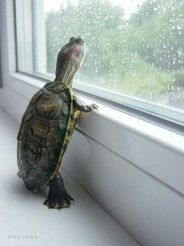
Thursday, February 19th
Write a simple sentence about the image to the right.
Add whichever Brushstroke (1-4) you would like. Identify it at the end of your sentence. Be prepared to explain why you used it.
Make sure to punctuate. ☺

Slide 8
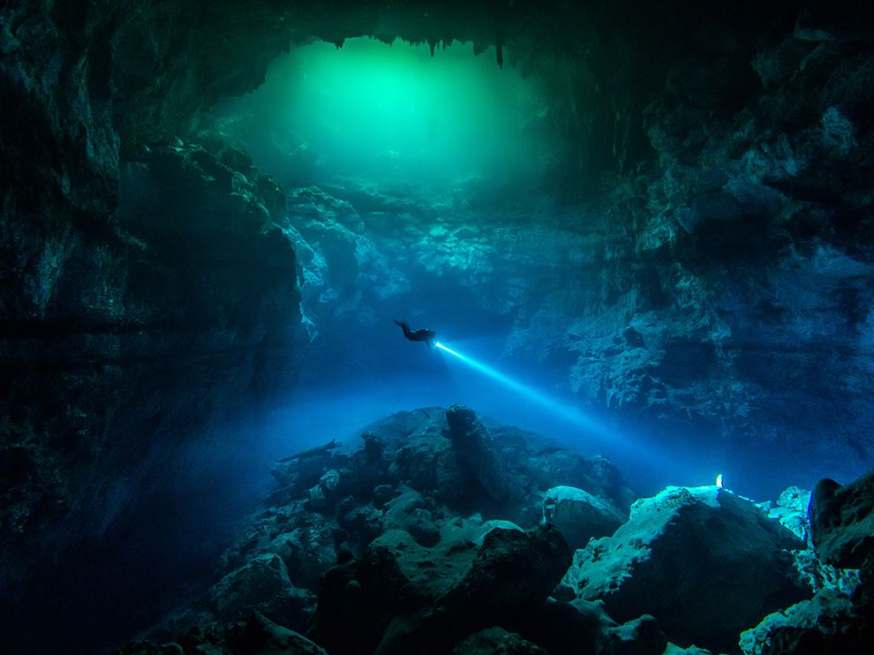
Friday, February 20th
Write a simple sentence about the image to the right.
Add whichever Brushstroke (1-4) you would like. Identify it at the end of your sentence. Be prepared to explain why you used it.
Make sure to punctuate. ☺

