Slide 1
Hercules and his 12 Labors
By:Leslie Montes, Elizabeth Garcia, & Faith Kaminski

Slide 2
Hercules Faith
Hercules prayed to apollo for help, the god told him he would have to serve Eurystheus
(the king of Tiryns and Mycenae)for twelve years in punishment for the murders.
His symbol is a lightning bolt and
clouds because of his father (Zeus)

Slide 3
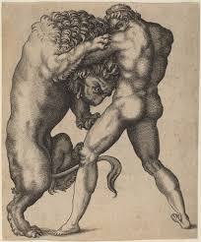
Labor #1Elizabeth
He was to kill the lion of Nimea
No weapon could hurt it
He then killed the beast
by choking it

Slide 4
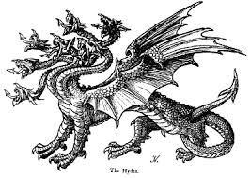
Labor #2Leslie
He was to kill Lernaean Hydra, a creature with nine heads that lived in a swamp
One of them was immortal and the rest grew back
He then cut off eight heads
burned the wounds and
buried the creature
under a giant rock

Slide 5
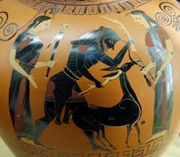
Labor #3Eli
He was sent to fetch the Hind of Ceryneia
But Hercules couldn’t kill or hurt it for it was Diana’s pet (the
goddess of hunting and
the moon)
He shot her either way
and was forgiven

Slide 6
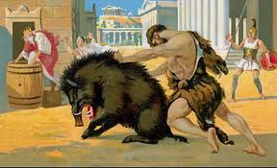
Labor #4Leslie
He was to capture a great boar called Hus Erymanthus
It lived in Mount Erymanthus
He finally managed to
trap it by driving it
deep into a snowbank

Slide 7
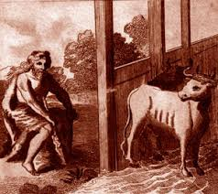
Labor #5Eli
He was sent to clean the Augean stables in a single day.
Thousands of cattle and hasn’t been clean for years
He diverted the courses
of two
rivers and made them flow
through the stables that
cleaned
all the filth.

Slide 8
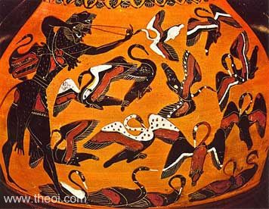
Labor #6Leslie
His task was to drive away the enormous flock of brass clawed man-eating birds
He frightened the birds out of
the marsh using athenas
rattle then
shot them dead with
poisoned arrows

Slide 9
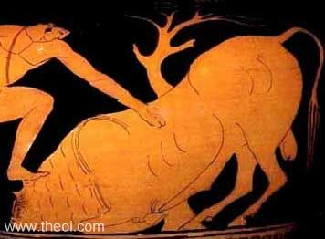
Labor #7Eli
Capture Tauros Kretaios (fire belching bull)
Captured it single handedly and carried it to a ship that would take it to King Eurytheus

Slide 10
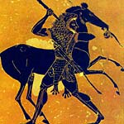
Labor #8Leslie
Capture the wild horses of Diomedes (ate human flesh)
First killed the owner
Seduced horses by feeding them their owners flesh and carried them
to his cousin

Slide 11
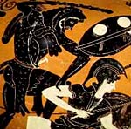
Labor #9Eli
Bring back the girdle of Hippolyta
The Queen of Amazons still held her bitter grudge and stirred up trouble
He then killed the queen without any hesitation and seized her girdle

Slide 12
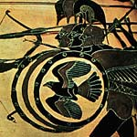
Labor #10Leslie
Capture the Cattle of Geryon animal with three bodies
He had to first kill the giant Erytion and its two headed dog

Slide 13
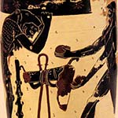
Labor #11Eli
Bring back The Golden Apples of the Hesperides
Asked atlas for directions and agreed to get the apples for Hercules
Atlas refused to take back the world

Slide 14
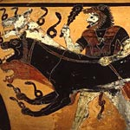
Labor #12Faith
His last task was to bring Cerberus alive from the lower world
Obtained permission from pluto to carry Cerberus to the upper world (no weapons)
He then had been detained
there for an unsuccessful
attempt
to carry off Proserpine.

Slide 15
ArchetypesFaith
The hero
(Hercules)
Father-Son conflict
(Zeus and Hercules)
The Creature of Nightmare
(all the beasts he fought)

Slide 16
ThemesFaith
Listen to the Gods
Innocent people die for no apparent reason

Slide 17
Works Cited
“The Labors of Hercules.”Perseus Project N.D. Web. 8 apr. 2015
Press, Petra. "Chapter 2." Great Heros of Mythology. Print. Pg.37
Encyclopedia of Mythology. 4th ed. Vol. 3. Print. Pg.516

