Slide 1
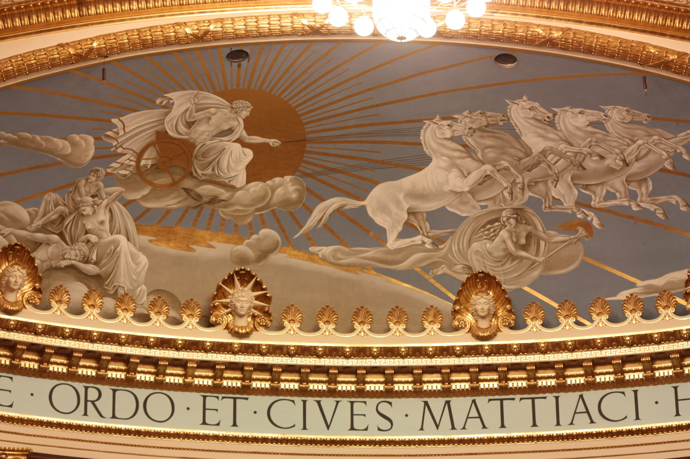
Greek Mythology Research Project
Phaeton & Helios
By Eric Smith, Julian Ordaz, & Findlay Yepo

Slide 2
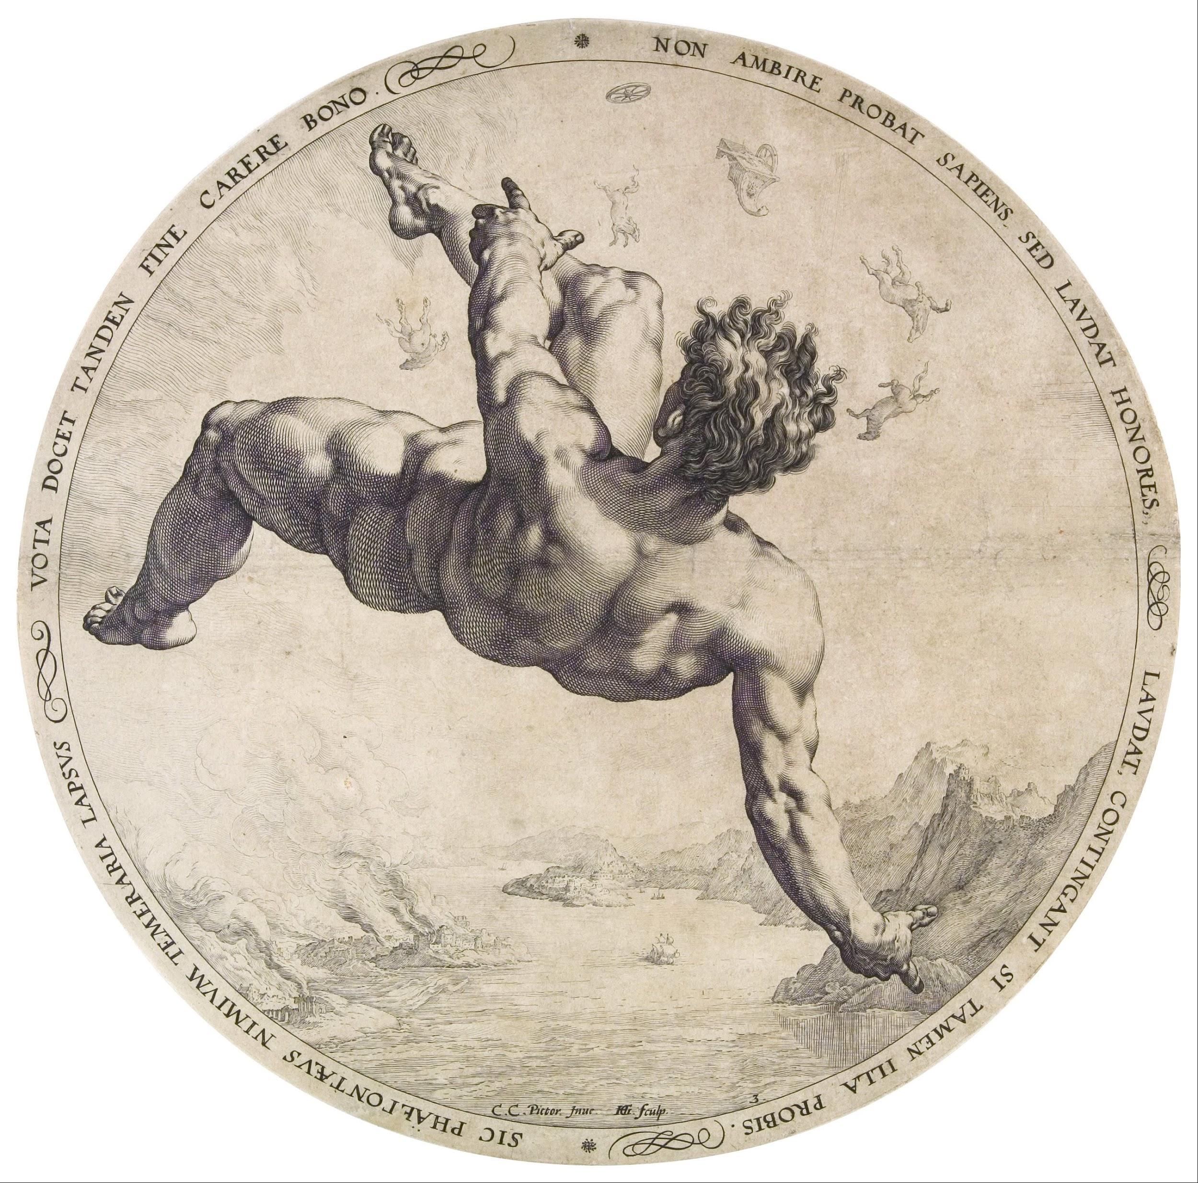
Phaeton
Son of Helios
Son of Klymene
Demigod
Created the Sahara Desert

Slide 3
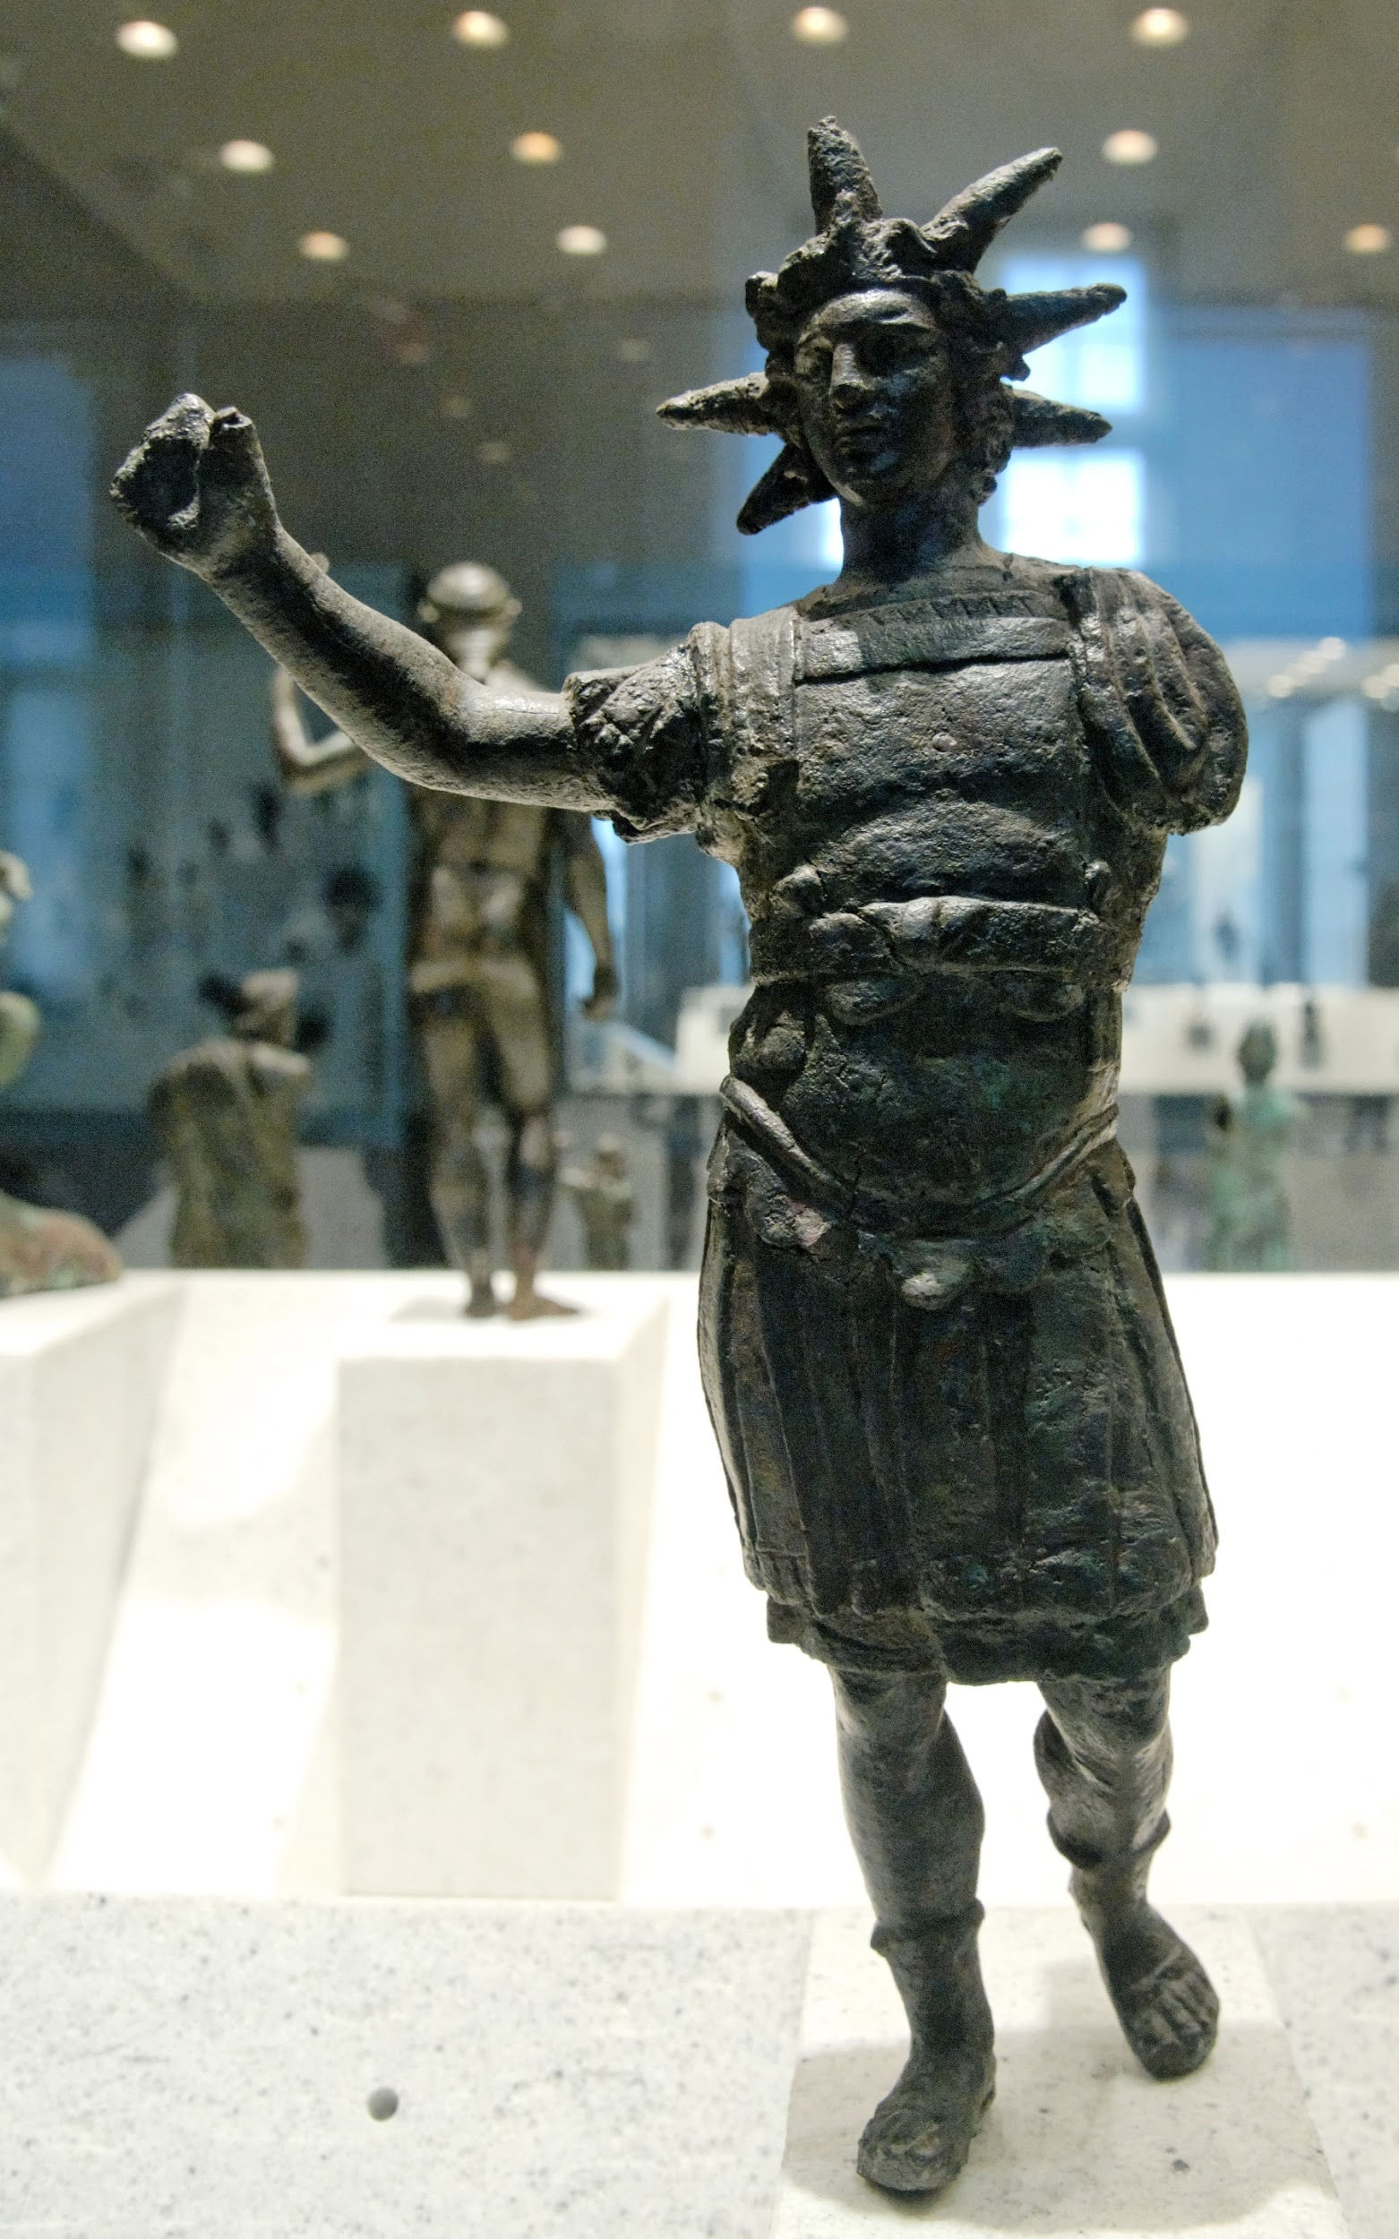
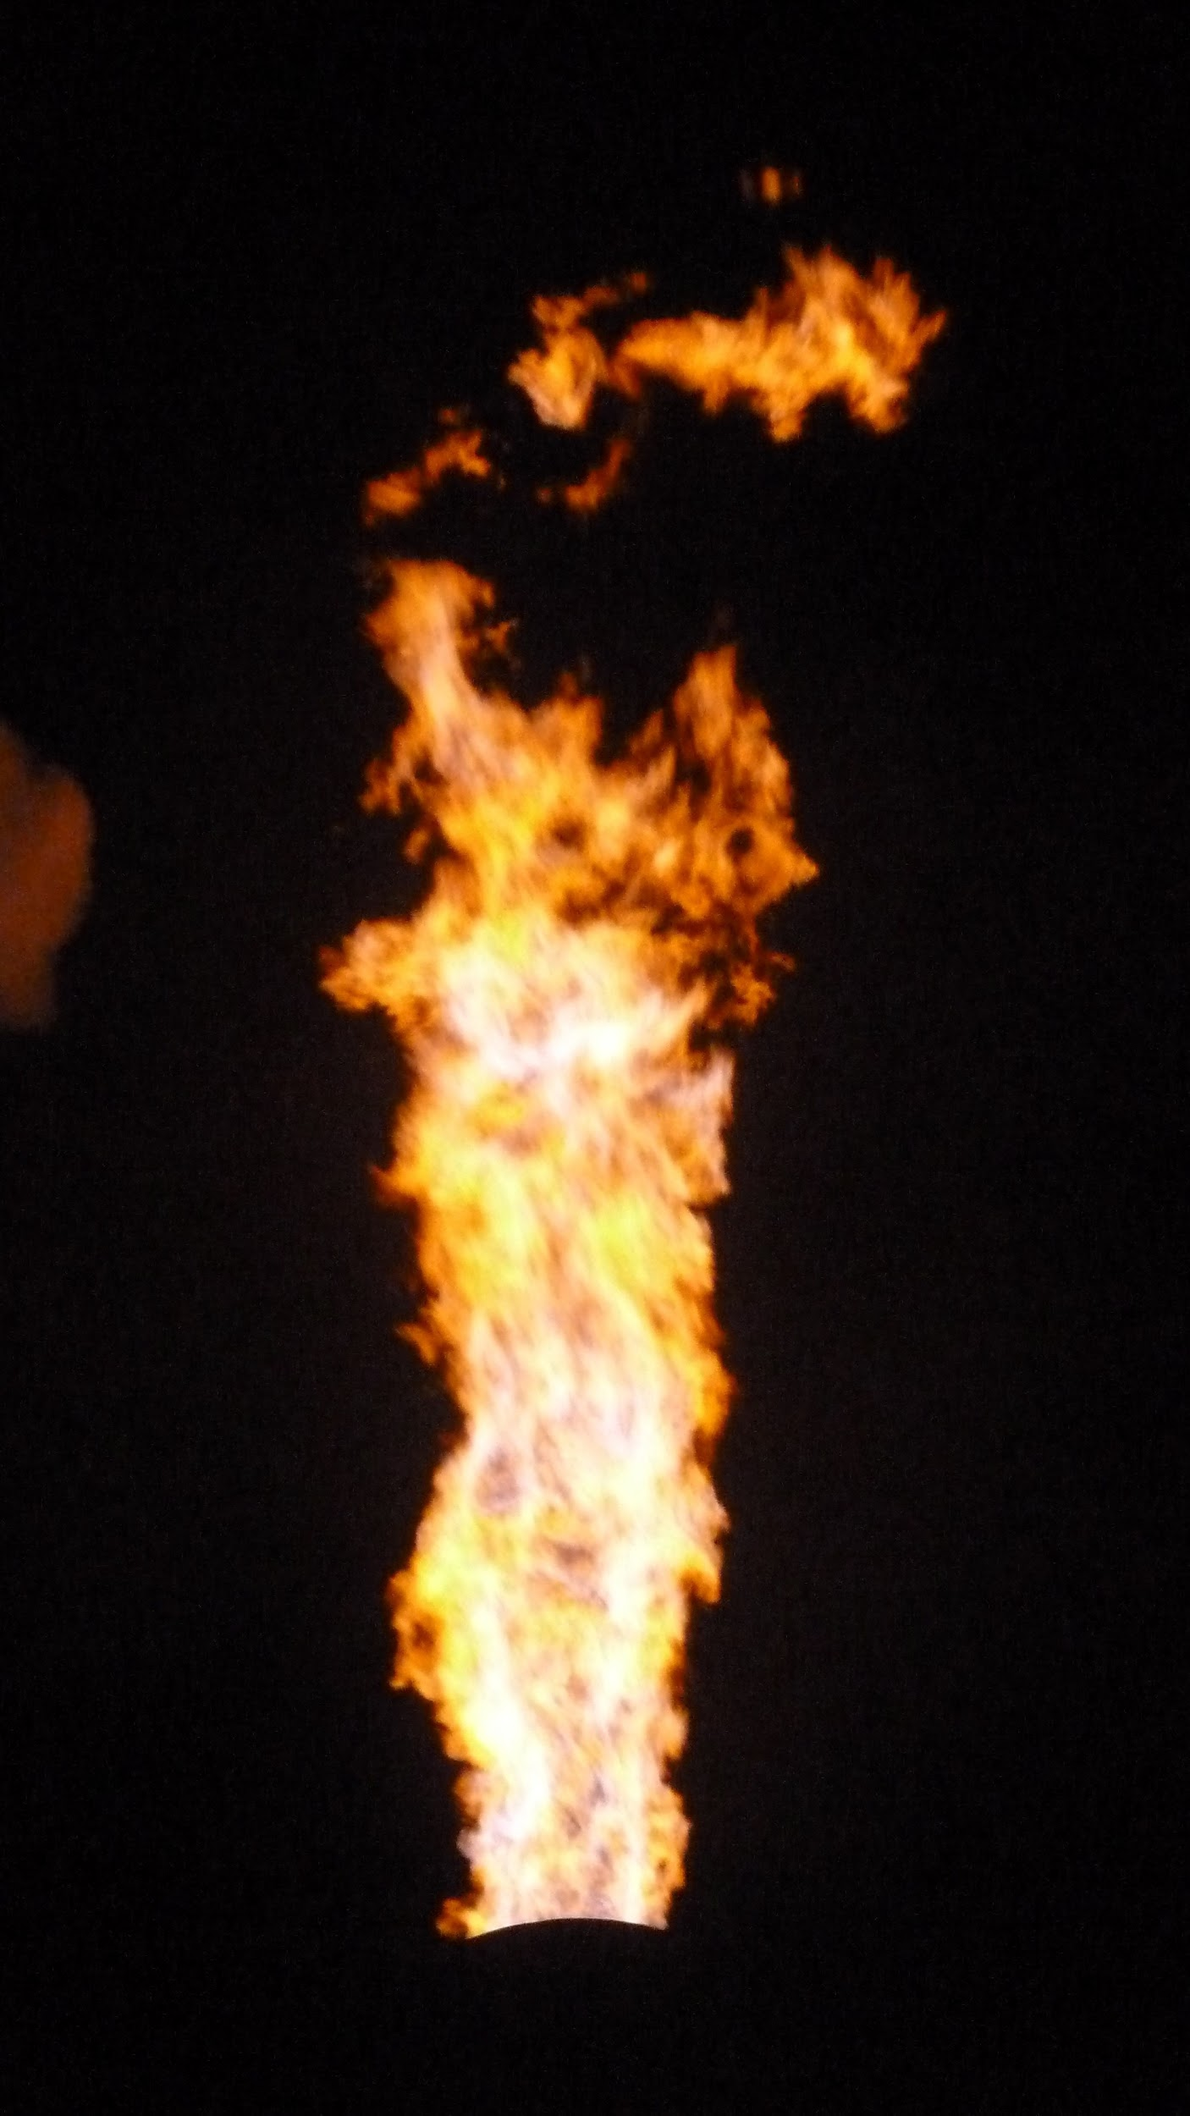
Helios
Sun God
Father of Phaeton
Rides the Chariot of Fire

Slide 4
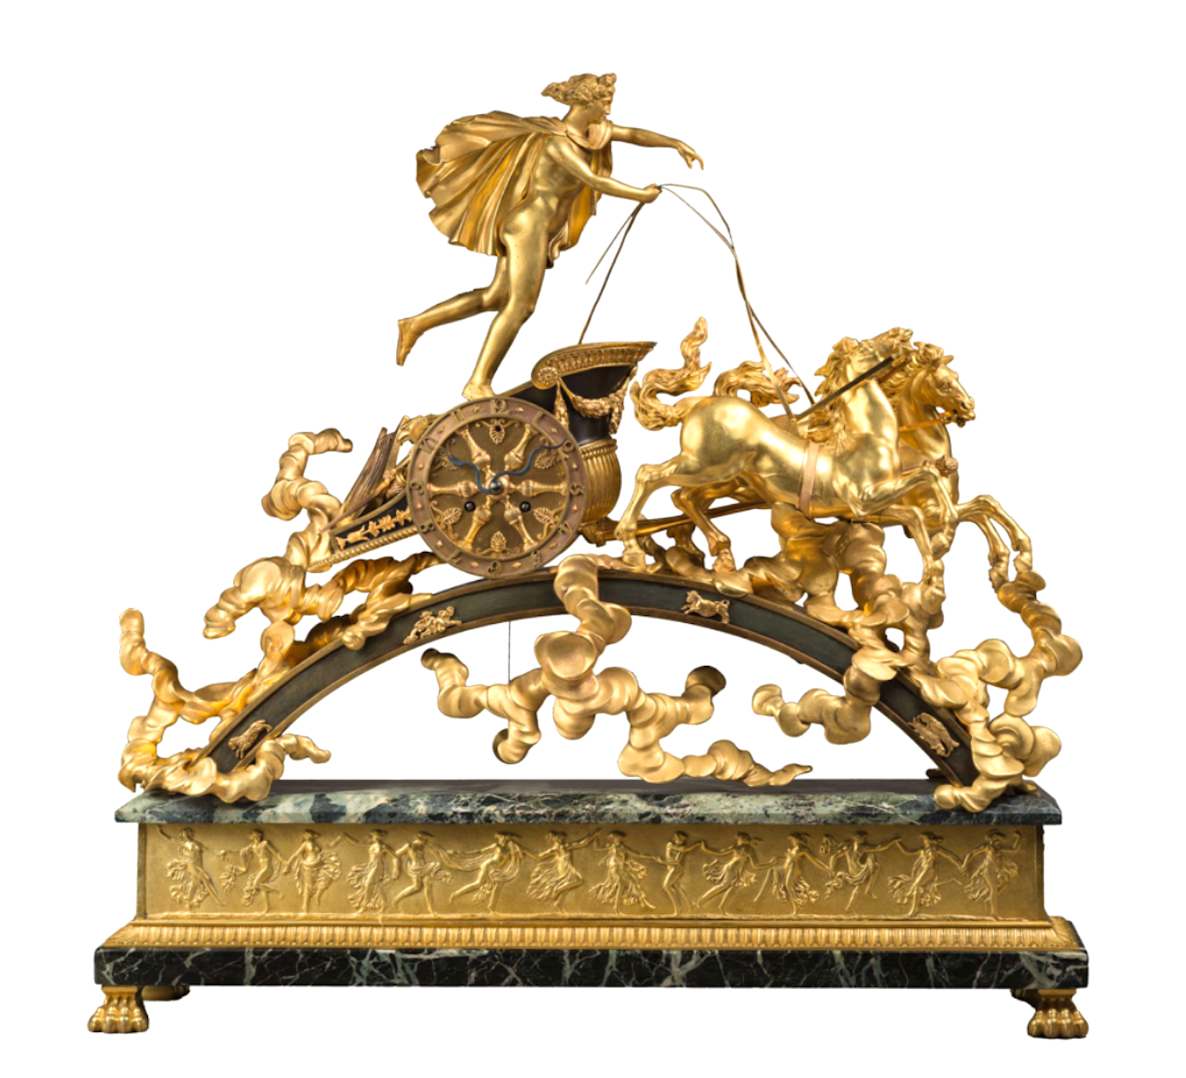
The Myth
Phaeton questions if his father is Helios
Asks mother, Klymene, for proof
Searches for father in India
Finds father in India
Begs father to lend him sun chariot
Loses control and burns Africa
Zeus’ thunderbolt knocks him off
Falls to death
After death became constellation Auriga
Also said he became God of Stars
Name means the shining to radiant one

Slide 5
Archetype
Fire and Ice
Spiritual Intervention
Father-Son Conflict
Helios represents intelligence and wisdom.
Phaeton represents ignorance and stupidity.
Zeus intervenes when he is angered by Phaetons ignorance.
Phaeton has slowly grown distant from his father and is unable to see reason when told of potential consequences.

Slide 6
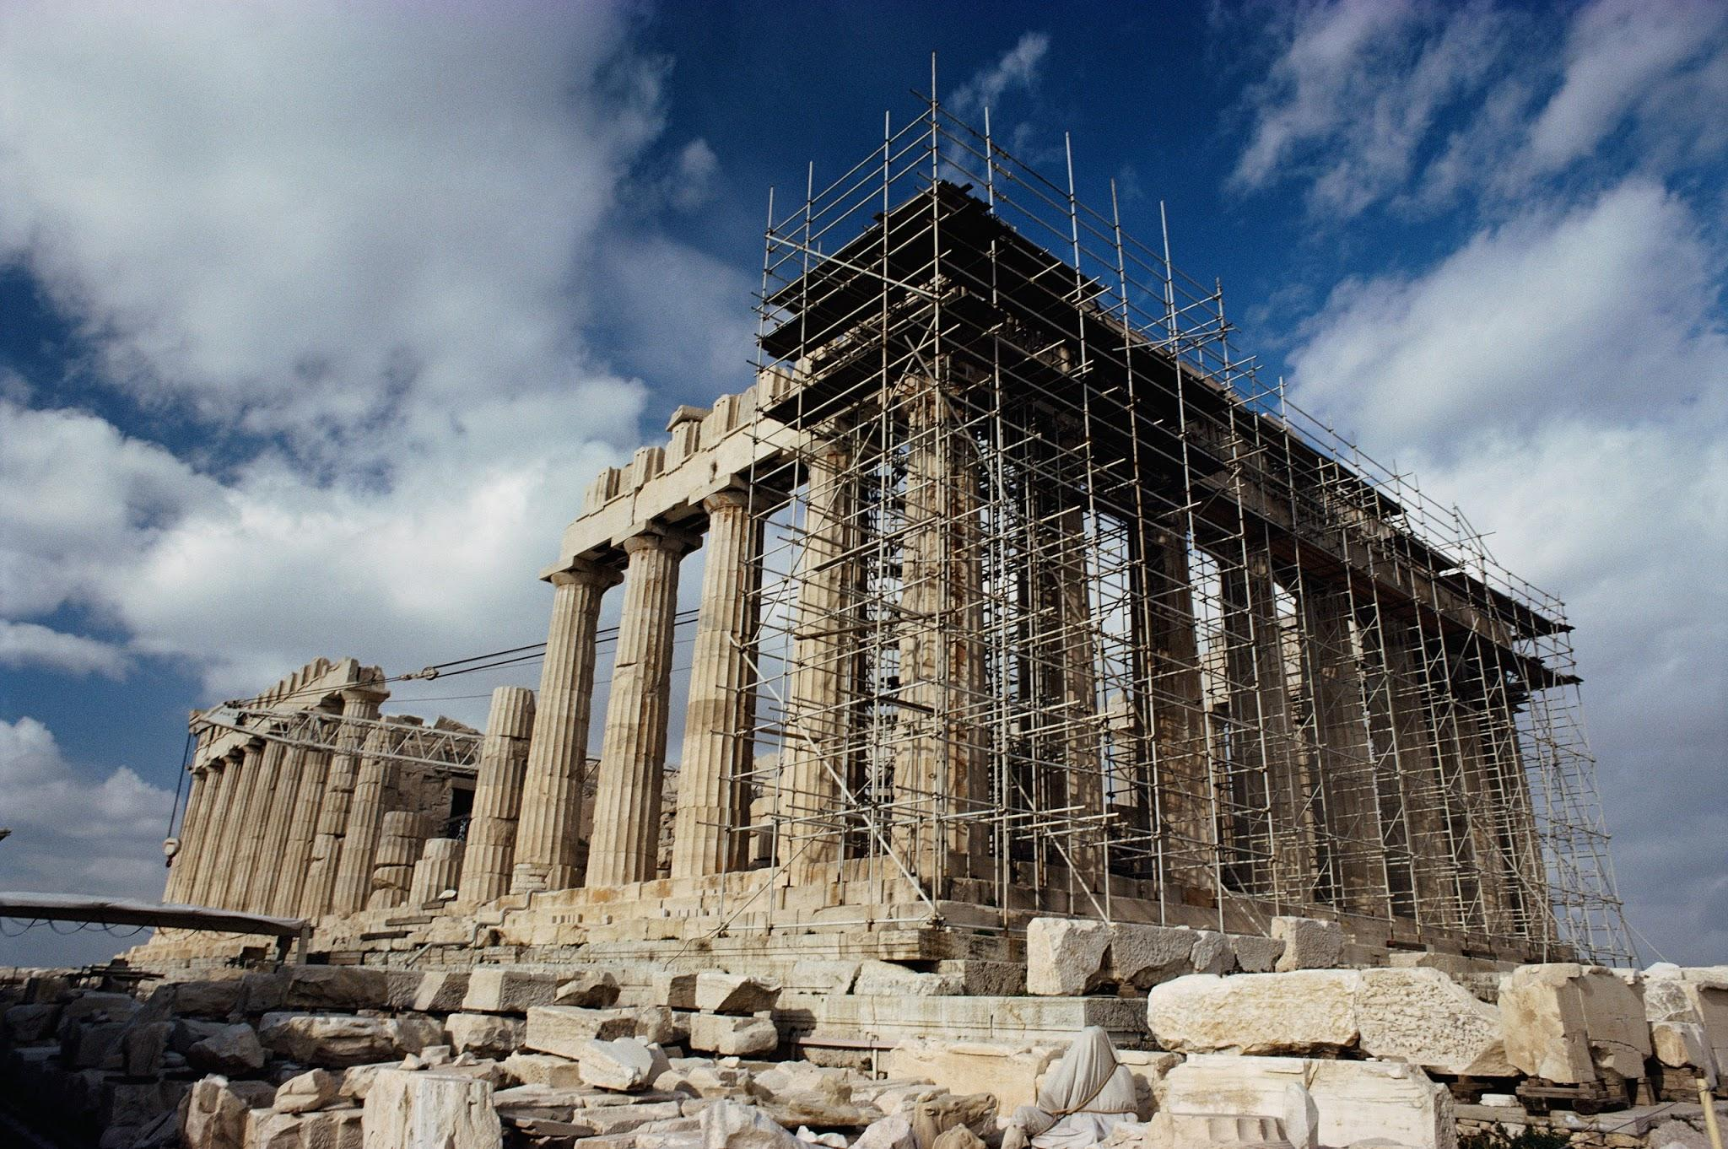
Greek Culture
This myth illustrates that...
The greek culture takes pride in individuals being able to prove themselves.
Trust has to be earned, not given
Parents believe in their kids, and the belief can be misleading
Promises can be consequential

Slide 7
Bibliography
"PHAETHON : Greek Demigod Child of the Sun ; Mythology ; Contellation Auriga." Theoi Greek Mythology. Web. 8 Apr. 2015. <http://www.theoi.com/Titan/Phaethon.html>.
Parks, James, and Sally Corbett. Phaeton and the Chariot of the Sun. Print.
Goltzius, Hendrick. The Fall of Phaeton. Digital image. The Tale of Helios and Phaethon. 16 Aug. 2009. Web.
Mercatante, Anthony S., and James R. Dow. The Facts on File Encyclopedia of World Mythology and Legend. 2nd ed. New York, NY: Facts on File, 2004. 415. Print.
Jordan, Michael. Dictionary of Gods and Goddesses. 2nd ed. New York: Facts on File, 2004. 120. Print.

