Slide 1
Helios and Phaëthon
By Pamela Ramirez, robyn alba, michelle yi

Slide 2
Helios
Sun God
Possessed and was in guard of driving the ‘chariot of the sun’.

Slide 3
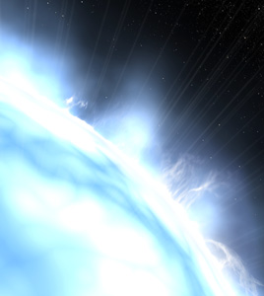
Phaëthon
A mere mortal
Son of Helios (god) and Klymene (human)
Drove the chariot of the sun
Was killed by Zeus
Became constellation Auriga

Slide 4
The Myth
Phaëthon enters Helios’ Palace when Helios, his father, is about to leave for his daily task.
Before Helios leaves Phaëthon questions his father whether he can drive the sun chariot for one day.
Helios denies him at first, however because he swore upon by the River of Styx, he gave into Phaëthon’s wish.
Upon Phaëthon’s leave, he does well driving the chariot, but winds up losing control of it, and scorches the heavens and Earth.
The enraged constellations demanded Zeus handle the situation.
Zues, infuriated and shocked, shot the chariot with a thunderbolt which then caused it to explode sending Phaëthon flying into the Po River in which he died.
Helios never let anyone else drive his chariot again.

Slide 5
Archetypes
The Father-Son Conflict
Helios and Phaëthon
Supernatural Intervention
Zeus
The Fall
Phaëthon’s fall from the chariot into the Po River.

Slide 6
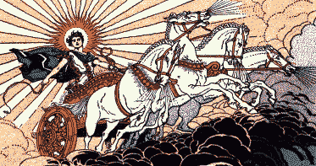
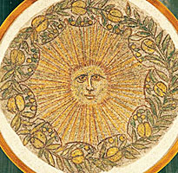
Greek Culture
Being hubristic and arrogant can cause tragic consequences for a mortal.
Gods take personal interest in their children.
Mortals wanted the power of and attention from the gods.

Slide 7
Works Cited
Aulaire, Ingri, and Edgar Parin Aulaire. Ingri and Edgar Parin D'Aulaire's Book of Greek Myths. Garden City, N.Y.: Doubleday, 1962. 82-85. Print.
Low, Alice, and Arvis L. Stewart. The Macmillan Book of Greek Gods and Heroes. New York: Macmillan Pub. ;, 1985. 60-65. Print.
"PHAETHON : Greek Demigod Child of the Sun ; Mythology ; Contellation Auriga." PHAETHON : Greek Demigod Child of the Sun ; Mythology ; Contellation Auriga. Ed. Aaron Atsma. Theoi Project Copyright, 2011. Web. 8 Apr. 2015. <http://www.theoi.com/Titan/Phaethon.html>.

