Slide 1
Heroes of the Trojan War
By: David Briseno, Beck Brown, Jack Helsten, Brandon De la cruz

Slide 2
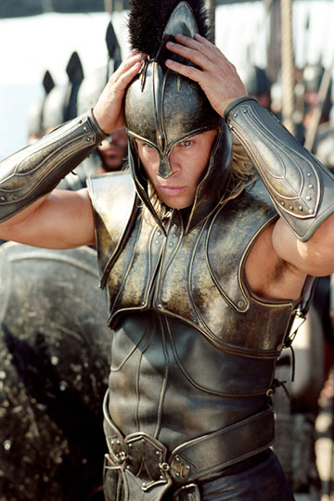
Achilles
Achilles- This warrior is the greatest on the Greek. His father is Peleus, a great warrior in his own right, and his mother is Thetis, a sea nymph. Achilles kills Hector, but is killed by a poisoned arrow in the heel, the only vulnerable place on his body.
myths-son of Peleus
Mightiest of greeks
Hero of Homer’s lliad

Slide 3
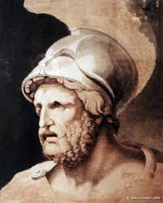
Nestor
Nestor- the son of Neleus and Chloris and the king of Pylos. Nestor became the king after Hercales killed Neleus and all of Nestors brothers and sisters.
Role in the Trojan War
his role is largely to incite the warriors to battle and to tell stories of his early exploits, which contrast with his listeners’ experiences, shown to be soft and easy in comparison with his own. In the Odyssey he tells Telemachus about the sufferings and trials he and others endured during the Trojan War.

Slide 4
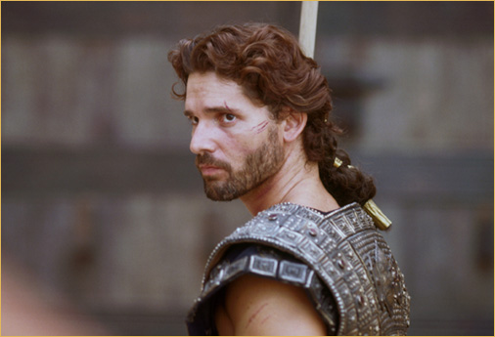
Hector
Hector, in Greek legend, the eldest son of the Trojan king Priam and his queen Hecuba. He was the husband of Andromache and the chief warrior of the Trojan army. In Homer's Iliad he is represented as an ideal warrior and the mainstay of Troy.
Role in the Trojan war
Was the the eldest son of the Trojan king Priam and his queen Hecuba.

Slide 5
Agamemnon
king of Argos
Commander of greeks in Trojan war
Murdered by his wife, Clytemuestra
Was the father of four children
Agamemnon was very arrogant and saw people under him in the social pyramid.

Slide 6
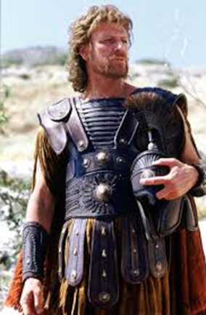
Odysseus
Was a legendary Greek king
A hero of Homers epic poem the Odyssey.
Is renowned for his brilliance, guile, and versatility.
Myth-
Odysseus was often called "Odysseus the Cunning" because of his clever and quick mind. Autolysis, his grandfather, was a famous skilled thief in the Peloponnese. The Romans transformed the name Odysseus to Ulysses and that is how he is mostly known today all over the world.

Slide 7
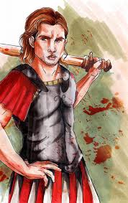
patroclus
Was the son of Menoetius, grandson of Actor, and King of Opus
Achilles's beloved comrade and brother-in-arms
Later killed by hector
Myth-In his youth, Patroclus killed his friend, Clysonymus, during an argument. His father had to escape into exile with Patroclus to escape punishment, and they took shelter at the palace of their kinsman King Peleus of Pthia. There Patroclus apparently first met Peleus' son Achilles. Peleus sent the boys to live in the wilderness and be raised by Chiron, the wise King of the centaurs

Slide 8
Archetypes
The Hero- almost all the characters save the day.
The Initiates- Petroclus was trained by Achilles before the War.
The Unfaithful Wife- Agamemnon’s wife betrayed and tricked him into his death.
The Unhealable Wound- Paris puts an arrow through Achilles heel to kill the hero.

Slide 9
Works Sited
U*X*L Encyclopedia of World Mythology. Detroit: U*X*L/Gale, 2009. Print.
"Hector | Greek Mythology." Encyclopedia Britannica Online. Encyclopedia Britannica, n.d. Web. 08 Apr. 2015.
"Olympus Library - Myths: Tale of Achilles." Olympus Library - Myths: Tale of Achilles. N.p., n.d. Web. 08 Apr. 2015.

