Slide 1
Baucis and Philemon Myth
Hermes and Zeus
By: Rose Barakat, Kenia Arias, and Patricia Dentinger

Slide 2
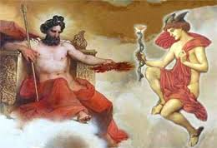
Hermes and Zeus
Hermes
God of Transition and Boundaries
Son of Zeus
Quick and cunning
Zeus
God of the sky and thunder
Ruler of Mount Olympus
Child of Cronus and Rhea

Slide 3
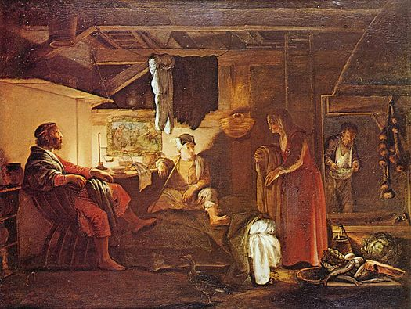
Baucis and Philemon
Baucis
Married to Philemon
Lived in region of Tyana
Philemon
Married to Baucis
Caring attitude (hospitable)

Slide 4
Baucis and Philemon Myth
Zeus and Hermes traveled through a village dressed as peasants asking for hospitality.
The pair was rejected by all except one couple, Baucus and Philemon, who kindly welcomed them into their home and treated them like royalty.
After discovering the two men were gods, they praised them. Soon after, The Gods told them to flee from the village because they were planning on flooding a village.
Once the town was flooded, the two gods created a temple for the generous couple.
The couple also wished to die together when their time came. Upon their death they were turned into a pair of intertwining trees.

Slide 5
Archetypes
The Whirlpool
The Flood caused by Zeus and Hermes because of the rejection of hospitality
Death and Rebirth
Upon their death, the couple was reincarnated into a pair of trees.
The Crossroads
The couple had to decide whether they were going to welcome the ‘homeless men’ into their home.

Slide 6
Greek Culture
This myth illustrates that Greeks believed …
Things are never as they seem
Justice must prevail
Generosity is a key to happiness
Always help those in need

Slide 7
Works Cited
Elsheimer, Adam. Jupiter and Mercury in the House of Philemon and Baucis. Digital image. Wikipedia. 1 Jan. 1608. Web.
Espeland, Pamela, and George Overlie. The Story of Baucis and Philemon. Minneapolis: Carolrhoda, 1981. Print.
"HESIOD'S FAMILY TREE OF THE GREEK GODS." Greek Gods & Goddesses. Web. 7 Apr. 2015. <http://www.theoi.com/greek-mythology/greek-gods.html>.
Zeus and Hermes. Digital image. Merkaba Activations. Web.

