Slide 1
Perseus and the gorgon (medusa)
By: Diana Aguilar, Annabelle Alvarez, and Luisa Andreu

Slide 2
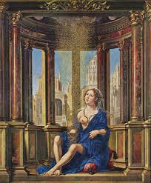
Danaё
Daughter of Acrisius, King of Argos.
Mother of Perseus.
According to prophecy, Acrisius was to one day be killed by his grandson.
Because of the prophecy, Danaё was locked in a tower by Acrisius to prevent her from having children.
One of Zeus’ love affairs.

Slide 3
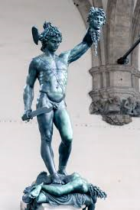
Perseus
Son of Danaë and Zeus.
Grandson of Acrisius.
Famous Greek hero.
Slayer of Medusa.

Slide 4
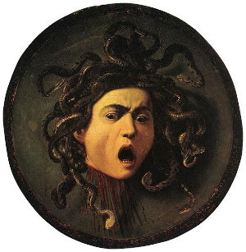
Medusa
Hideous monster known as a Gorgon.
Daughter of Phorcys, a God of the sea, and Ceto, a female sea God.
Anyone who looked directly at Medusa was instantly turned into stone.
Had poisonous snakes instead of hair.
Killed by Perseus.

Slide 5
myth
Apollo’s prophecy said that King Acrisius was to one day be killed by his grandson.
To prevent his own death, he locked Danaë, his only daughter, in a tower.
By her eighteenth year, Zeus discovered a way into the tower and took her as his lover.
She later gave birth to Perseus.
The infuriated King casted them both out onto open sea.

Slide 6
Myth (Continued)
After time elapsed from being freed, King Polydectes longed to marry Danaë.
Perseus forbade their marriage.
King faked a different marriage in order for Perseus to bring a gift.
Perseus, being unwealthy, could not bring a gift.
The King asked for him to bring Medusa’s head as a replacement.
Perseus accepted the challenge and successfully seeked out Medusa and beheaded her.
On his journey back home, he used her head in other life threatening situations.
Perseus was furious to find out that the King continued to pursue his mother that he turned King Polydectes and his soldiers into stone using the head of Medusa.

Slide 7
Archetypes
The Tower/ The Castle
- Danaë’s tower
The Task
- Perseus’ quest
The Shadow
- Medusa

Slide 8
This myth is related to greek culture
Acts of:
Love
Courage
Intelligience
Believing in yourself

Slide 9
citations
"Medusa: Facts About the Ancient Gorgon." Primary Facts. James, 21 Nov. 2013. Web. 7 Apr. 2015. <http://primaryfacts.com/3154/medusa-facts-about-the-ancient-greek-gorgon/>.
Day, Malcolm. "Descendants of the Titans." 100 Characters from Classical Mythology. Hauppauge: Barron's Educational Series, 2007. 54. Print.
Press, Petra. "Heroes of Classical Greek Mythology." Great Heroes of Mythology. New York: Metro, 1997. 30-34. Print.

