Slide 1
Persuasive Techniques Notes

Slide 2
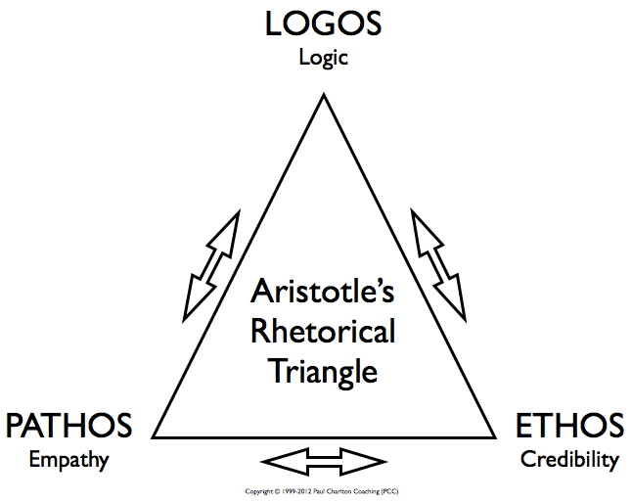
Rhetorical appeals:
The three major persuasive strategies used to support arguments. A good writer will use all three about equally to successfully create an effective argument/persuasive piece.
***Use these in your Persuasive Essays!!

Slide 3
1. Logos= Logic
(Appeal to the sense of reason)
How to do it: Use statistics, details, examples, facts, explain cause and effect, compare and contrast, etc.
Warning: A good/fair writer will not use logical fallacies.
Fallacy: A misleading argument/a logical mistake

Slide 4
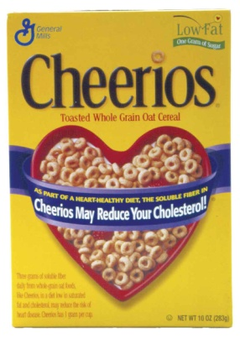
Logos Examples

Slide 5
2. Pathos = Emotion.
(Appeal to emotions and deeply held beliefs.)
How to do it: Powerful diction (emotional words), detailed and impactful imagery, anecdotes (individual, personal, emotional stories), interviews, allusions to deeply loved stories/beliefs, music;.
Warning: A good/fair writer will not use too much pathos.

Slide 6
Pathos examples

Slide 7
3. Ethos = Ethics/credibility.
(Appeal to the need for a believable and ethical author)
How to do it: Refer to credible sources/people, don’t make facts up, respect the audience’s intelligence/beliefs in your tone, don’t make too many grammar/spelling mistakes.
Use counterargument: acknowledge/recognize the opposing viewpoint with respect before you say why it’s wrong (“So-and-so has a point that XYZ; however, consider this point…”)
Warning: A good/fair writer can never have too much ethos!

Slide 8
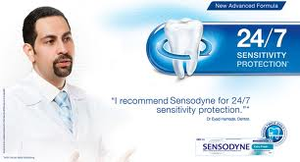
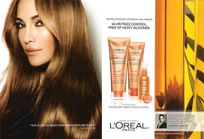
Ethos examples

Slide 9
Rhetorical Analysis of an Advertisement
Logos (Choose at least one)
What reasons do the advertisers give to convince buyers?
What examples, facts, details, or statistics do they use?
Pathos (Answer both)
List at least one-two strong words that pop out to you (diction). What emotions are these words supposed to make you feel?
What imagery do they use?
What is the imagery supposed make you feel?
Ethos (Choose at least one):
Does the ad refer to experts, trusted people, or brands? Who?
Do they show respect to their audience? How do you know?
Do they show proof that their product works? How?
Do they show they care about you? How do you know?

