Slide 1
Baucis and philemon
Characters : Zues And hermes

Slide 2
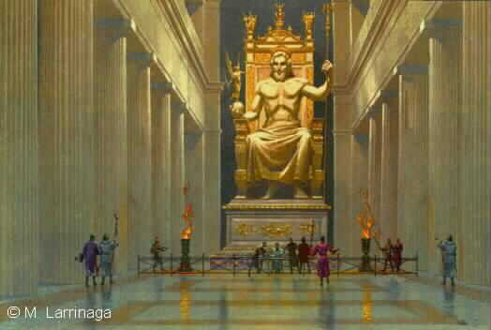
Zeus
Character: Zeus is the child of Cronus and Rhea, and the youngest of his siblings. He is the god of sky and thunder and the ruler of the Olympians of Mount Olympus. In most traditions he is married to Hera.
Appearance: Zeus was strong and imposing, with long hair, most of the time curly hair.

Slide 3
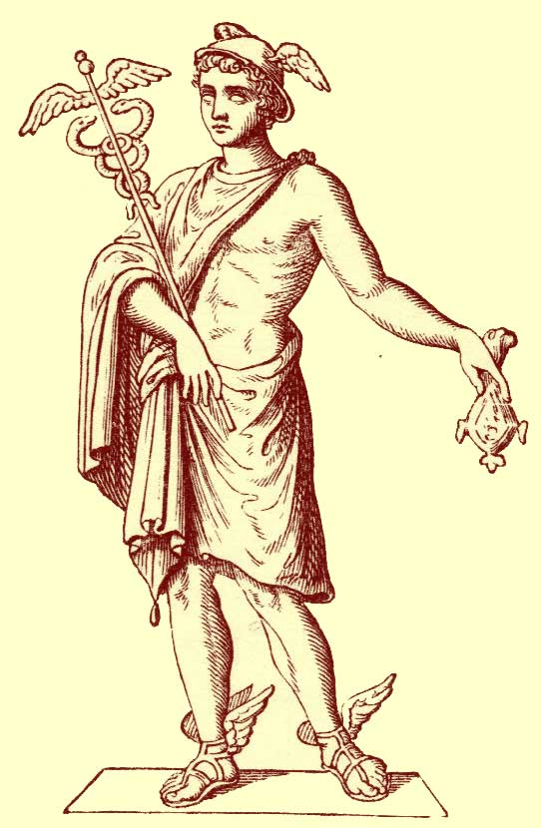
Hermes
Character: Hermes is an Olympian god, son of Zeus and the Pleiad Maia. He is a god of transitions and boundaries. He is protector and patron of travelers, herdsmen, thieves, orators and wit, literature and poets, athletics and sports, invention and trade.
Appearance: Hermes was a young unshaven man, wearing traveling clothes, a flat hat, and winged sandals on his feet Hermes usually held a winged staff with snakes wrapped around it in his hands in order to gain access everywhere.

Slide 4
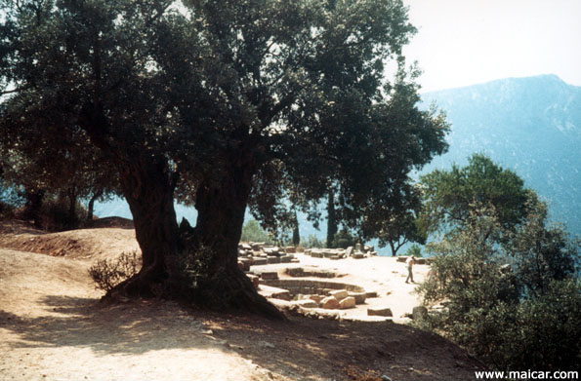
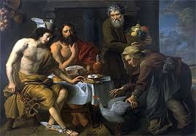
Myth
Zeus and Hermes disguise as peasants to test the people.
After many attempts they came across a couple, Baucis and Philemon, that took them in and cared for both Zeus and Hermes.
In order to repay the favor Zeus and Hermes Granted G & P their utmost wish, to be together.
Baucis and Philemon were turned into a tree which sprouted into two different trunks.

Slide 5
Themes
What goes around comes around
Love never dies

Slide 6
Archetypes
Loyal Retainers
(HERMES)
The Journey
(Hermes and Zeus are testing the people)

