Slide 1
The Judgment of Paris
He judged…
…Not the other way around

Slide 2
Characters
Eris: Goddess of discord (disagreements)
Aphrodite: Goddess of love/beauty (Trojan)
Hera: Goddess of family/childbirth (Greek)
Athena: Goddess of wisdom/battle strategy (Greek)
Paris: A Trojan Prince
Helen: Wife of Menelaus, ½ mortal daughter of Zeus, “The Face That Launched A Thousand Ships”
Menelaus: King of Sparta (Greek city-state)

Slide 3
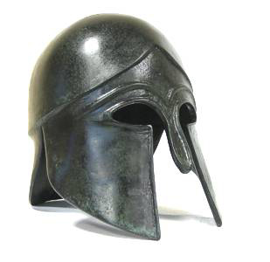

Slide 4
Myth
Eris snubbed at marriage of Thetis and Peleus
Golden apple: “To The Fairest”
Aphrodite, Athena, and Hera claim it
Paris is asked to decide (judge)
Each goddess offers bribes
Chooses Aphrodite’s (Most beautiful woman, Helen)
She transports him to Menelaus’ estate
Treated as a guest
Menelaus leaves
Paris takes (a willing) Helen to Troy
Trojan War
All Greeks help Menelaus retrieve Helen (oath)
Athena and Hera help the Greeks (Achaians)

Slide 5
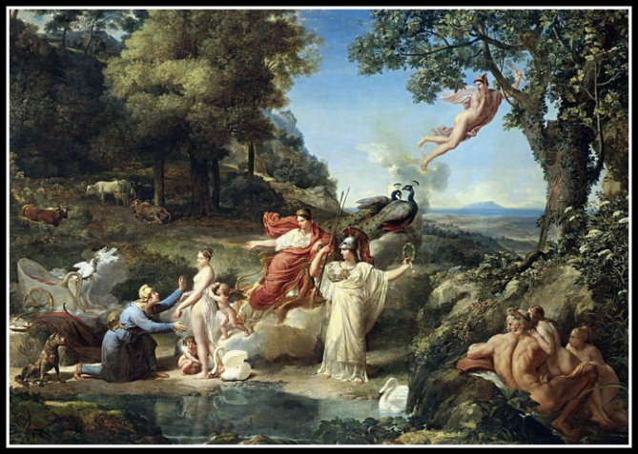

Slide 6
Archetypes
The Temptress(es)
Aphrodite, Athena, Hera, Eris, Helen
The Unfaithful Wife
Helen
Battle Between Good and Evil
Paris abused hospitality, making him and his cause morally wrong (doomed from the start)
Hospitality = reciprocity = peace
Scapegoat
Paris responsible for war/judgment

Slide 7
Themes/Greek Culture
Hospitality is the foundation of society; if it is abused, society will be in a tumult.
The gods/goddesses were seen more like very powerful humans (good traits but unpredictable).
They don’t always act in humankind’s interest
All the more reason to worship them!! Even if it’s illogical.

Slide 8
Works Cited
Bulfinch, Thomas. Bulfinch's Mythology Illustrated. New York: Avenel, 1978. 211-213. Print.

