Slide 1
Greek Mythology Projects Notes

Slide 2
The oresteia
Group #1:

Slide 3
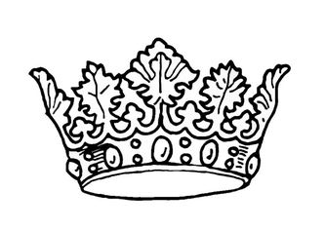
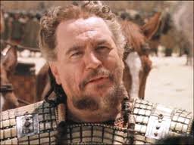
Characters: Agamemnon
King of Mycenae/Argos
Commander of Greeks in Trojan War
Celebrated Greek hero
Murdered by Clytemnestra (wife)
Father of 4 (Orestes, Elektra)
(You can put the name, symbol, and description on one page (#1-2))

Slide 4
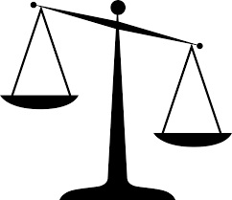
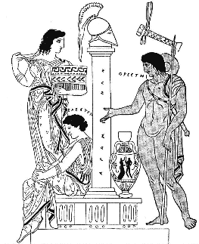
Characters: Orestes
Son of Agamemnon
Avenges his father’s death
Model Greek son

Slide 5
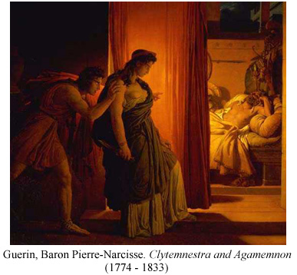
Myth
Agamemnon leads the Trojan War (10 yrs)
Wife took a lover, Aegisthus
Tricked/killed Agamemnon
Aegisthus is king for 7 yrs; Orestes gone

Slide 6
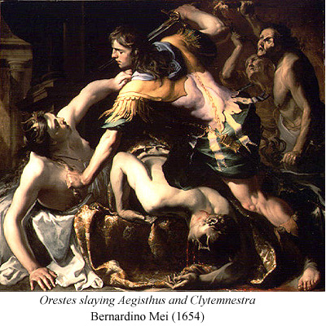
Myth Continued
Orestes returns; Apollo’s oracle/Elektra (sister) push him to revenge.
Disguised, Orestes kills mother and lover
Fates pursue him until Athena pardons

Slide 7
Archetypes
The Unfaithful Wife
Clytemnestra
Young One From The Provinces
Orestes
The Battle Between Good and Evil
Orestes upholds good

Slide 8
Greek Culture
This myth illustrates that the Greeks believed…
Justice must prevail.
Loyalty is a priority.
The father-son relationship is sacred.
Patriarchy is the order of society.

Slide 9
Works Cited
Mercatante, Anthony and James R. Dow. “Orestes." The Facts on File Encyclopedia of World Mythology and Legend. New York: Facts on File, 2004. 663. Print.

