Slide 1
The story of Helios and Phaethon
By: Valeria Correa
Nadine Rivas
Krystal Archer

Slide 2
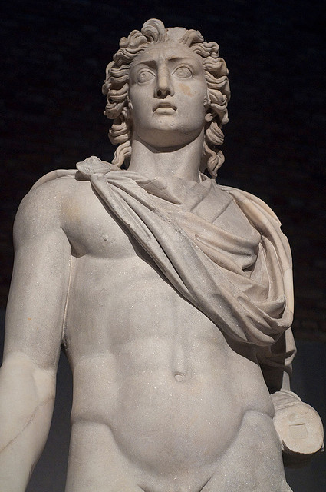
HELIOs
Titan god of the sun
Guardian of oaths and the god of gift of sight.
Handsome
Beardless
Man clothed in purple robes
Crowned with the shining aureole of the sun

Slide 3
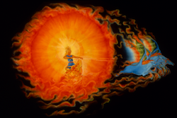
Phaethon
Known as the son of the Oceanid Clymene and Solar Deity Apollo
Name "Phaethon", means "Shining One”
He rebelled against his father quite often ☹

Slide 4
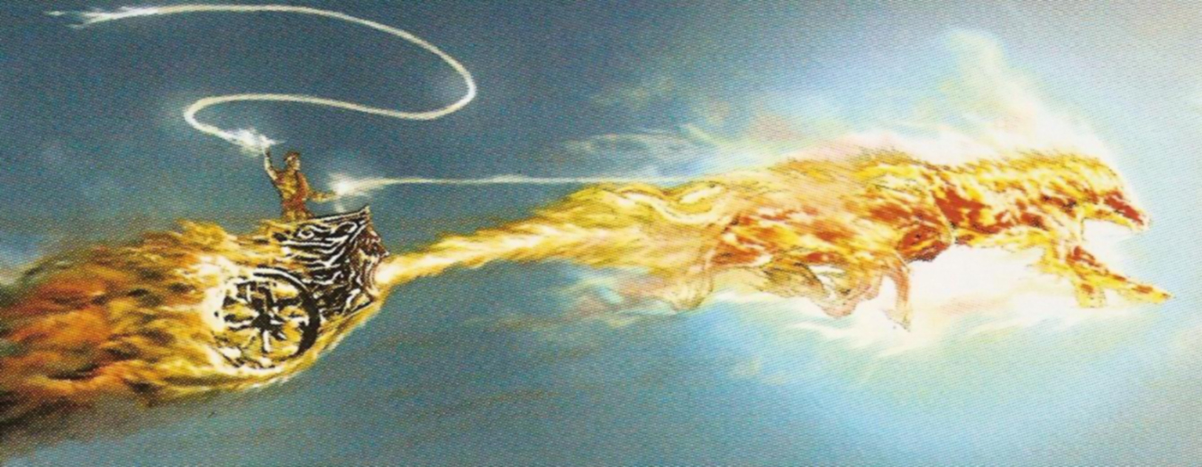
MYTH
Helios mounted his glowing chariot
He rashly swore by the river Styx to give his son any wish he wanted. (Phaethon)
Phaethon attempted to drive the chariot of the sun, but losing control, set the earth on fire.
Zeus then struck him down with a thunderbolt.
Helios grieved over his lost son, and never again allowed anyone to drive his chariot.
Except for Apollo, the god of light.

Slide 5
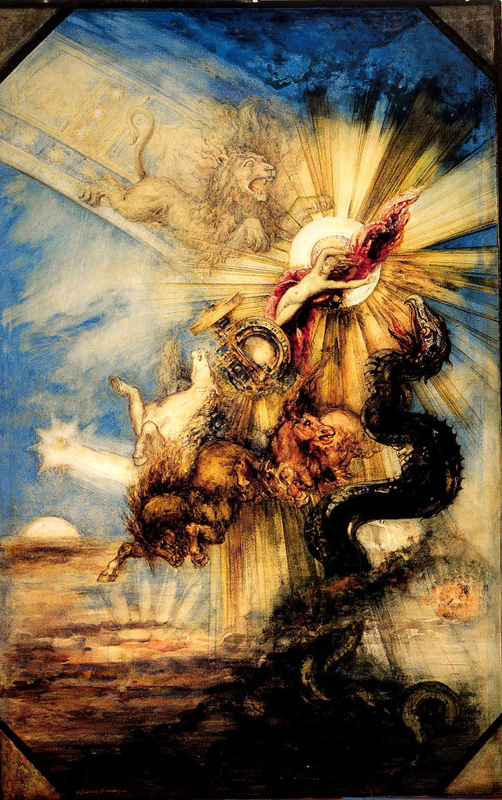
Helius god of the sun, Athenian red-figure krater
C5th B.C., British Museum, London

Slide 6
ARCHETYPES
UNDERWORLD – The earth
THE HERO – Helios
FATHER-SON CONFLICT – Helios and Phaethon

Slide 7
GREEK CULTURE
TRUST IS EASILY BROKEN.

Slide 8
SOURCES
URL:http://www.theoi.com/Titan/Helios.html
Article Title: HELIUS : Greek Titan god of the sun ; mythology ; pictures : HELIOS, SOL
Website Title:HELIUS : Greek Titan god of the sun ; mythology ; pictures : HELIOS, SOL
URL:http://www.theoi.com/Titan/Phaethon.html
Article Title:PHAETHON : Greek demigod child of the Sun ; mythology ; contellation Auriga
Website Title:PHAETHON : Greek demigod child of the Sun ; mythology ; contellation Auriga
D'Aulaire, Ingri, and Edgar Parin D'Aulaire. Ingri and Edgar Parin D'Aulaire's Book of Greek Myths. Garden City, NY: Doubleday, 1962. Print.

