Slide 1
Warm-Ups, NW3, Week 4
Focus on Brushstrokes (Participial phrase and absolutes)

Slide 2
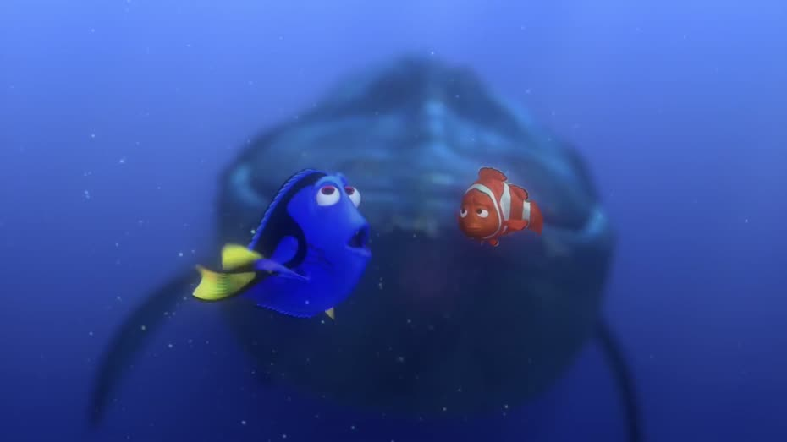
Monday, January 26
Brushstrokes Practice:
Write a simple sentence about the image to the right.
Add a participial PHRASE brushstroke
***Make sure you’re using a comma to punctuate!
Example (Random sentence):
Menacing the student’s every thought, glaring at him fiendishly, the blank paper refused to bloom into a finished essay.

Slide 3
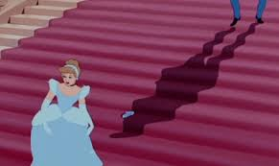
Tuesday, January 27th
Brushstrokes Practice:
Absolutes can be used to build anticipation toward the main sentence….
Write a simple sentence about the image to the right.
Add 1-3 absolute phrases
(Noun + participle)
***Make sure you’re using a comma to punctuate!
.
Example (Random sentence):
Toast burning, juice spilling, backpack missing, I ran out of the house at breakneck speed, only to miss the bus by a few seconds.
Instead of this: My toast was burning, I spilled my juice, and couldn’t find my backpack. I ignored these things and ran out of the house to catch the bus; however, I missed it by a few seconds.

Slide 4
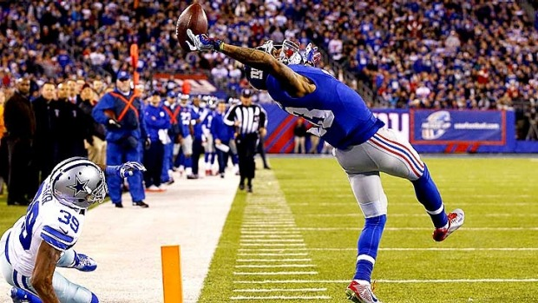
Wednesday, January 28th
Brushstrokes Practice:
Write a simple sentence about the image to the right.
Add 1-3 absolute phrases
***Make sure you’re using commas to punctuate!

Slide 5
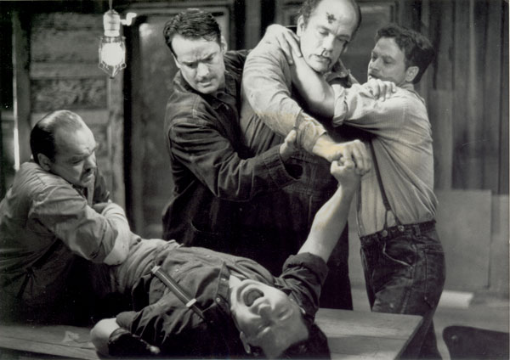
Thursday, January 29th
Brushstrokes Practice:
Write a simple sentence about the image to the right.
Add 1-3 absolute phrases.
Write an alternate version, but add only a participial phrase this time.
Make sure you’re using commas to punctuate!
Quiz tomorrow!

Slide 6
Friday, January 30th
Brushstrokes Practice:
Write a simple sentence about the image to the right.
Add a brushstroke (participles or participial phrases) to the beginning or end of the sentence.

