Slide 1
Warm-Ups, NW3, Week 3
Focus on Pronoun Problems

Slide 2
Monday, January 19
Copy the sentence ONCE. Double sp ace the sentence. Use editor’s marks to correct the sentence.
No sentence today

Slide 3
Tuesday, January 20th
Copy the sentence ONCE. Double space the sentence. Use editor’s marks to correct the sentence.
Pronoun-Antecedent Agreement, Punctuation (Title), Comma (Other), Spelling
My class read Jimmy Santiago Baca’s poem Fall, which I found very pleasant, and they did by the way inspire me to write a beutifull poem.

Slide 4
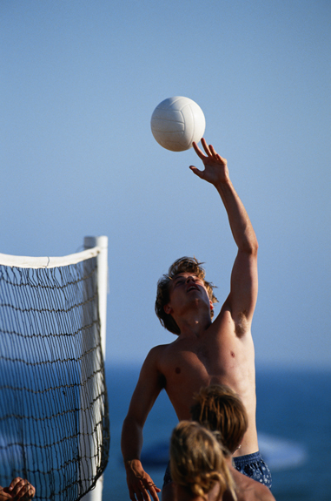
Wednesday, January 21st
Brushstrokes Practice:
Write a simple sentence about the image to the right.
Add a brushstroke (participles or participial phrases) to the beginning or end of the sentence.
Example: Straining with every fiber of his body, summoning every ounce of energy, the volleyball player reached for the ball only to miss it entirely.

