Slide 1
Zeus, Demeter, and Persephone
Kristen Byrne & Quinntess Cooney

Slide 2
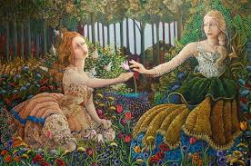
Zeus and Demeter
Zeus, known as the God of lightning and the Heavens
Had a child with Demeter, the goddess of harvest and growth.
They had a daughter Persephone
Persephone, goddess of the underworld
Abducted by Hades

Slide 3
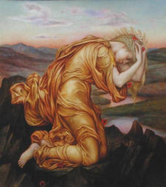
Myth
Persephone and Demeter were very close
Hades wanted Persephone
Demeter was distraught; stopped harvesting the Earth.

Slide 4
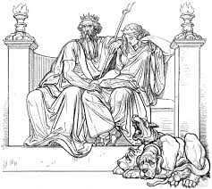
Myth (Cont.)
Zeus sent Hermes to retrieve Persephone
Persephone became Goddess of the Underworld
She returned to Demeter every Spring

Slide 5
Archetypes
Evil Figure With Ultimately Good Heart: Hades returned Persephone every Spring
Earth Mother: Demeter’s powers were growth and harvest
Underworld: Hades took Persephone to the literal Underworld

Slide 6
The Greeks’ Beliefs
Seasons was created from this story
Mother and Daughter relationships
Carefulness and Responsibility

Slide 7
Citations
Parin D' Aulaire, Ingri and Edgar. "Persephone and Demeter." D'aulaires‘
Book of GREEK MYTHS. New York: Bantam Doubleday Dell Group,
1962. 58-64. Print.
Pictures:
1 & 2 : greekgoddesses.wikia.com
3: shmoop.com

