Slide 1
Zeus, Demeter, Persephone
By : Eduardo Sano, Autumn O'Hara , Cesar Dominguez, Andres Silva.

Slide 2
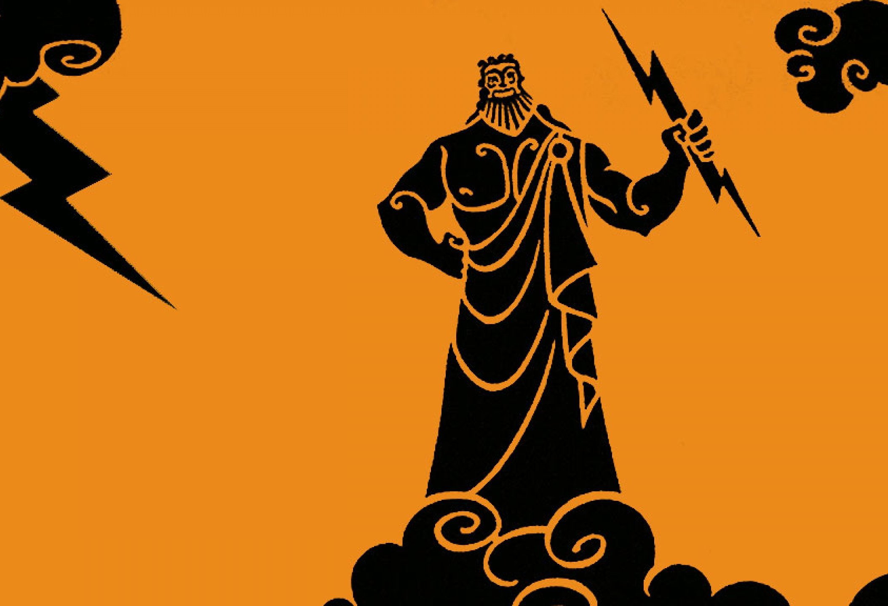
Characters
Zeus: God of the sky and ruler of the Olympian gods.
Married to his sister Hera, had many affairs, and fathered many children.
Strong and imposing, long often curly hair.

Slide 3
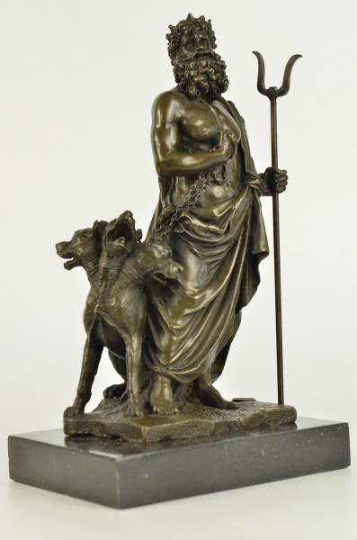
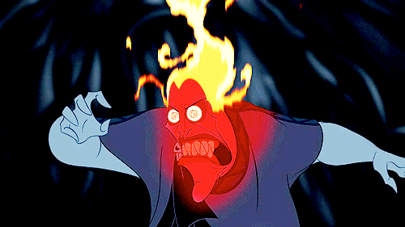
Characters
Hades: Ruler of the underworld and ruler of the dead.
Married to Persephone.
Gloomy features, bearded, dark hair falling over his brow.

Slide 4
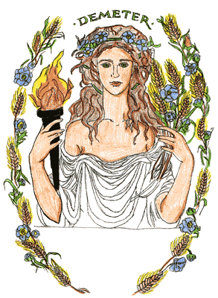
Characters
Demeter: Goddess of agriculture.
Zeus’ sister, child of Chronos and Rhea, mother of Persephone.
Rich haired, golden tresses, slender feet, wears light cloak, holds torch.
shown with a cornucopia or sheaves of wheat. She often carried a torch to guide her in search of Persephone

Slide 5
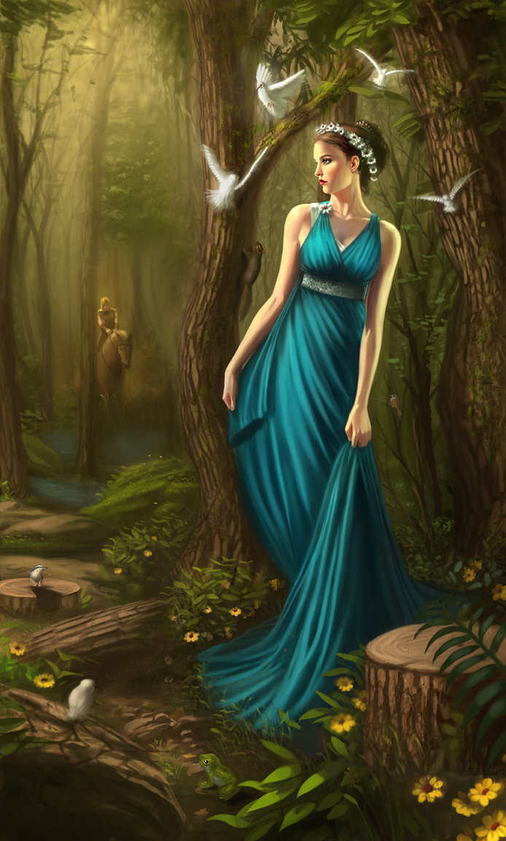
Characters
Persephone: daughter of Demeter and Zeus.
Married to Hades.
Beautiful young maiden.
Ate pomegranate.

Slide 6
Archetypes
Demeter: The earth mother
Persephone: Damsel in distress
Zeus: The Hero
Hades: Evil figure with ultimately good heart

Slide 7
Greek culture
The story reflects that Greek civilization attributed almost every enigma to actions of the gods.
Male gods were often more powerful than female ones.
Constant awareness of consequences of their actions.

Slide 8
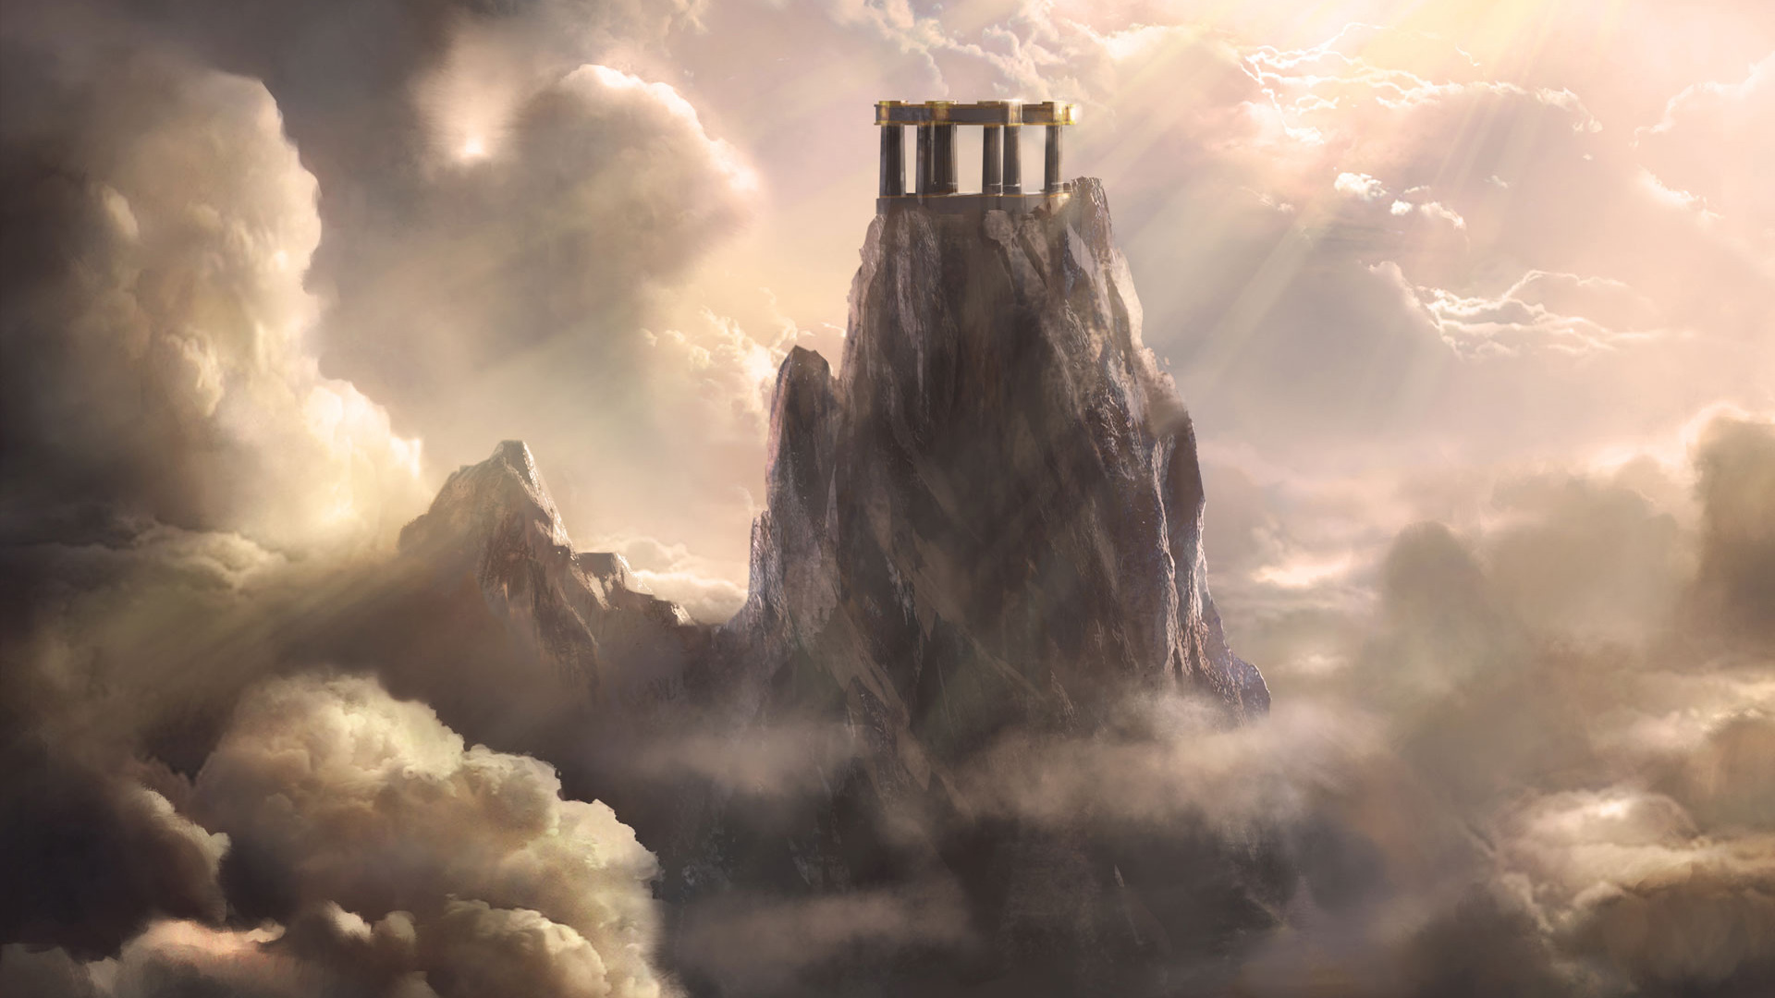
Themes
Love is present even among the gods.
Sadness can result in death.

Slide 9
Work cited
U.X.L. Encyclopedia of World Mythology (1st ed., Vol. 2, p. 293). (2009). Farmington Hills, MI: Gale.
GREEK MYTHOLOGY. (2009). Retrieved April 8, 2015, from http://www.history.com/topics/ancient-history/greek-mythology
Olympian Gods. (2000). Retrieved April 8, 2015, from http://www.greekmythology.com/Olympians/olympians.html

